Slide 1
Unified Mentor Internship
PROJECT REPORT
SUBMITTED BY
CHANDRAKANT BARIK
Intern ID UNID - UMID01062540399
DOMAIN: Frontend Development Intern
DURATION: 05/06/2025 to 05/08/2025(2 months)

Slide 2
Web Development - Basic Project details
COMPANY: Unified Mentor Pvt. Ltd
NAME: Chandrakant Barik
UNID INTERN ID: UMID01062540399
DOMAIN: Frontend Development Intern
DURATION: 05/06/2025 to 05/08/2025
Project 1 - weather app
Project 2 - image slider
Project 3 -Interactive quiz
Project 4 -Interactive Infographics
Web Development - Advance Project details
Project 5 - Secure & Share Govt Document with Family Project 6 - Members clinic management system
BASIC LINK
1)weather app Github Repository Link: https://github.com/chandrakant131103/Weather-APP---Unified-Mentor-UM-
2)image slider Github Repository Link : https://github.com/chandrakant131103/Image-Slider--Unifield-Mentor-UM-
3)interactive quiz Github Repository Link : https://github.com/chandrakant131103/interactive-quiz-Unified-Mentor-UM-
4)Interactive Infographics Github Repository Link : https://github.com/chandrakant131103/Interactive-Infographics-Unified-Mentor-UM-
ADVANCED LINK
5)Secure & Share Govt Document with Family Members Github Repository Link : https://github.com/chandrakant131103/Government-Document-Sharing-Portal-Unified-Mentor-UM-
Netlify Hosted Link : https://neon-hummingbird-3ec4fa.netlify.app/
6)clinic management system Github Repository Link : https://github.com/chandrakant131103/Clinic-Management-System---Unified-Mentor-UM-
Netlify Hosted Link : https://gregarious-naiad-8abe52.netlify.app/

Slide 3
COMPANY: Unified Mentor Pvt. Ltd
NAME: Chandrakant Barik
UNID INTERN ID: UMID01062540399
DOMAIN: Frontend Development Intern
DURATION: 05/06/2025 to 05/08/2025
This contains Github Links of ALL 6 projects assigned to Chandrakant Barik During Internship Period of Unified Mentor Frontend Development During the
duration of 4 June to 4 august. This also comprises of projects also presented in respective repo ,otherwise ,i have uploaded all the folder of files .In this also.
all respective Github Repository of 6 project under unified Mentor.
Basic
1)weather app Github Repository Link: https://github.com/chandrakant131103/Weather-APP---Unified-Mentor-UM-
2)image slider Github Repository Link : https://github.com/chandrakant131103/Image-Slider--Unifield-Mentor-UM-
3)interactive quiz Github Repository Link : https://github.com/chandrakant131103/interactive-quiz-Unified-Mentor-UM-
4)Interactive Infographics Github Repository Link : https://github.com/chandrakant131103/Interactive-Infographics-Unified-Mentor-UM-
advanced
5)Secure & Share Govt Document with Family Members Github Repository Link : https://github.com/chandrakant131103/Government-Document-Sharing-Portal-Unified-Mentor-UM-
Netlify Hosted Link : https://neon-hummingbird-3ec4fa.netlify.app/
6)clinic management system Github Repository Link : https://github.com/chandrakant131103/Clinic-Management-System---Unified-Mentor-UM-
Netlify Hosted Link : https://gregarious-naiad-8abe52.netlify.app/

Slide 4
(BASIC) PROJECT 1 -Weather App ABSTRACT EXPLAINATION
ALONG WITH GITHUB LINK FOLLOWED BY SCREENSHOT
This is a simple web-based weather app built using HTML, CSS, and JavaScript. It allows users to enter a city name and retrieve real-time weather data using the OpenWeatherMap API.
Features 1)Responsive design for mobile and desktop 2) Displays temperature, weather description, and icon 3)Handles empty input and invalid city errors 4) Integrates seamlessly with OpenWeatherMap API
How to Run the App
1)Open the index.html file with any modern browser. 2)Enter a city name (e.g., "Tokyo", "London", "Jodhpur") in the input field. 3)Click the Get Weather button or press Enter to retrieve weather info.If you click incorrect Then it will say api error or city not found.
Notes
1)Make sure your system is connected to the internet so API is fetched live weather condition. 2)Replace the API key in the JavaScript section if needed or if is not working. 3)if you deploy this app publicly, never expose your API key directly in the client-side code.
Responsive Design The app includes basic media queries for a smooth experience on devices with screens smaller than 600px.
Github Link : https://github.com/chandrakant131103/Weather-APP---Unified-Mentor-UM-

Slide 5
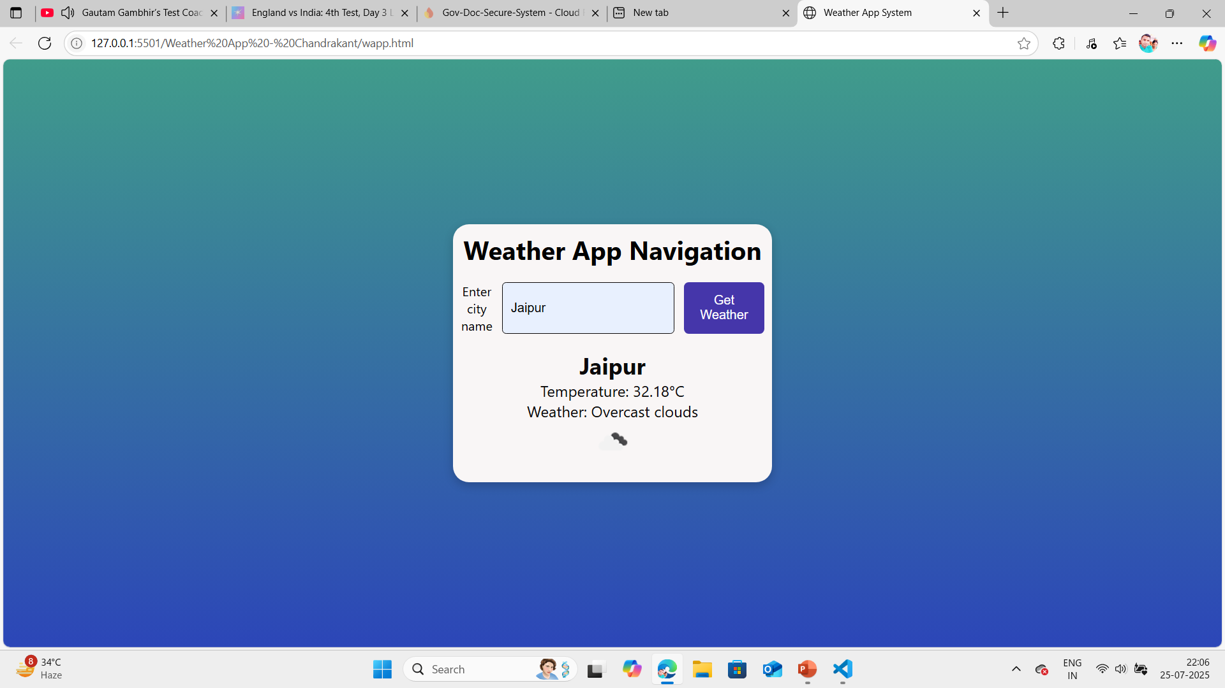
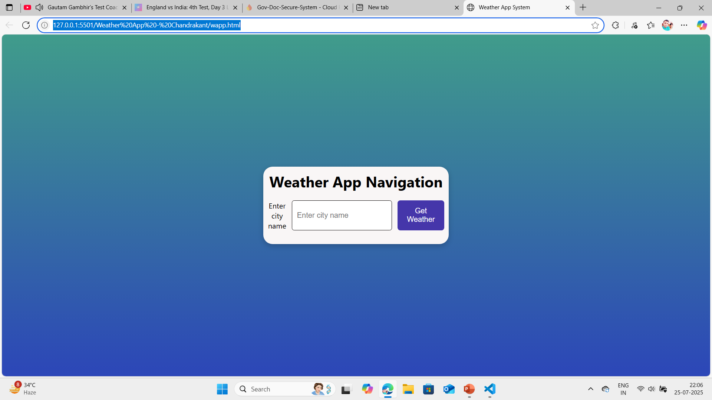
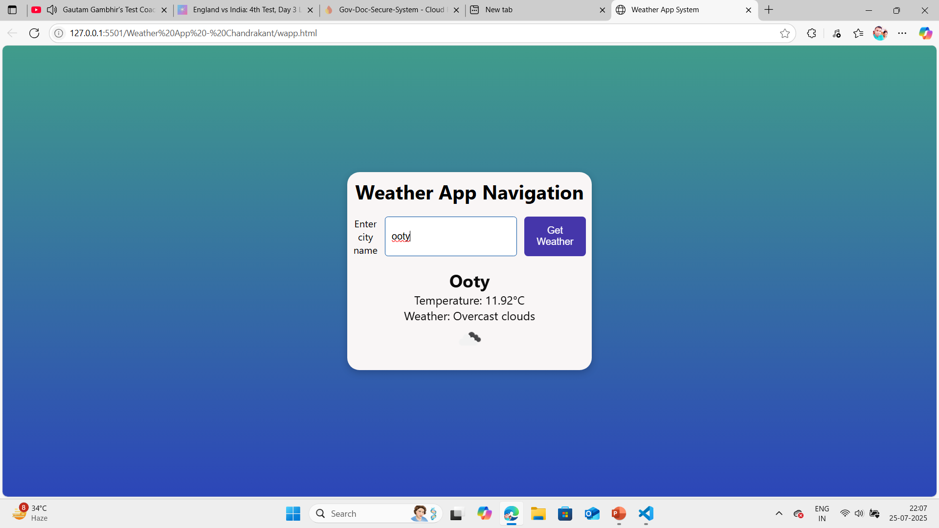
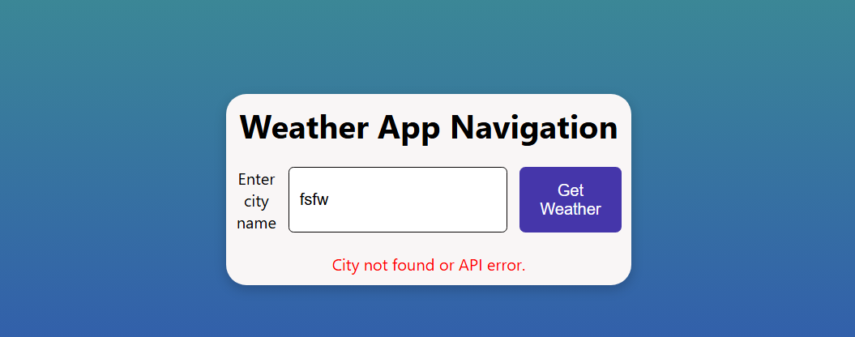
Project 1 –WEATHER APP
Including screenshots and explanation

Slide 6
(BASIC) Project 2 – Image Slider ABSTRACT EXPLAINATION
How to Run
Ensure all files are in the same directory.
Replace the placeholder image URLs in ischan.js with your own image paths is you want your
images to placed in it. I have publicly placed in images folder .
Open index.html in a web browser.
The automatic slideshow pauses briefly when navigation buttons are clicked and resumes afterward.
Features 1)Displays 5 images in a carousel format. 2) Supports "Previous" and "Next" navigation buttons.
3)Loops back to the first image after the last one (and vice versa). 4)Automatically transitions to the next image every 3 seconds.
Responsive design for desktop and mobile devices.
HTML,CSS,JS,ARRAY OF IMAGES, Automatic Slideshow: Add an option to make the slider automatically transition to
the next image after a certain interval (e.g., every 3 seconds).
JavaScript Functionality: Implement the JavaScript logic for the image slider. You should create functions to:
●Display the first image when the page loads.
● Allow users to click on "Next" and "Previous" buttons to navigate through the images.
● Loop back to the first image after reaching the last one.
GITHUB LINK : https://github.com/chandrakant131103/Image-Slider--Unifield-Mentor-UM-

Slide 7
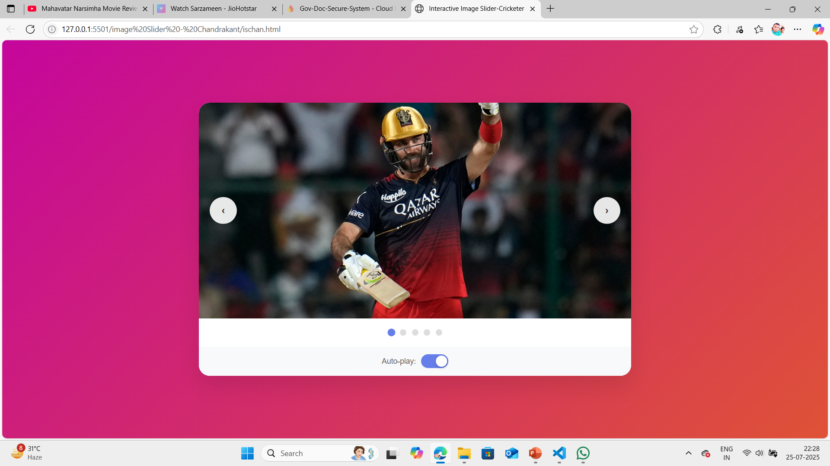
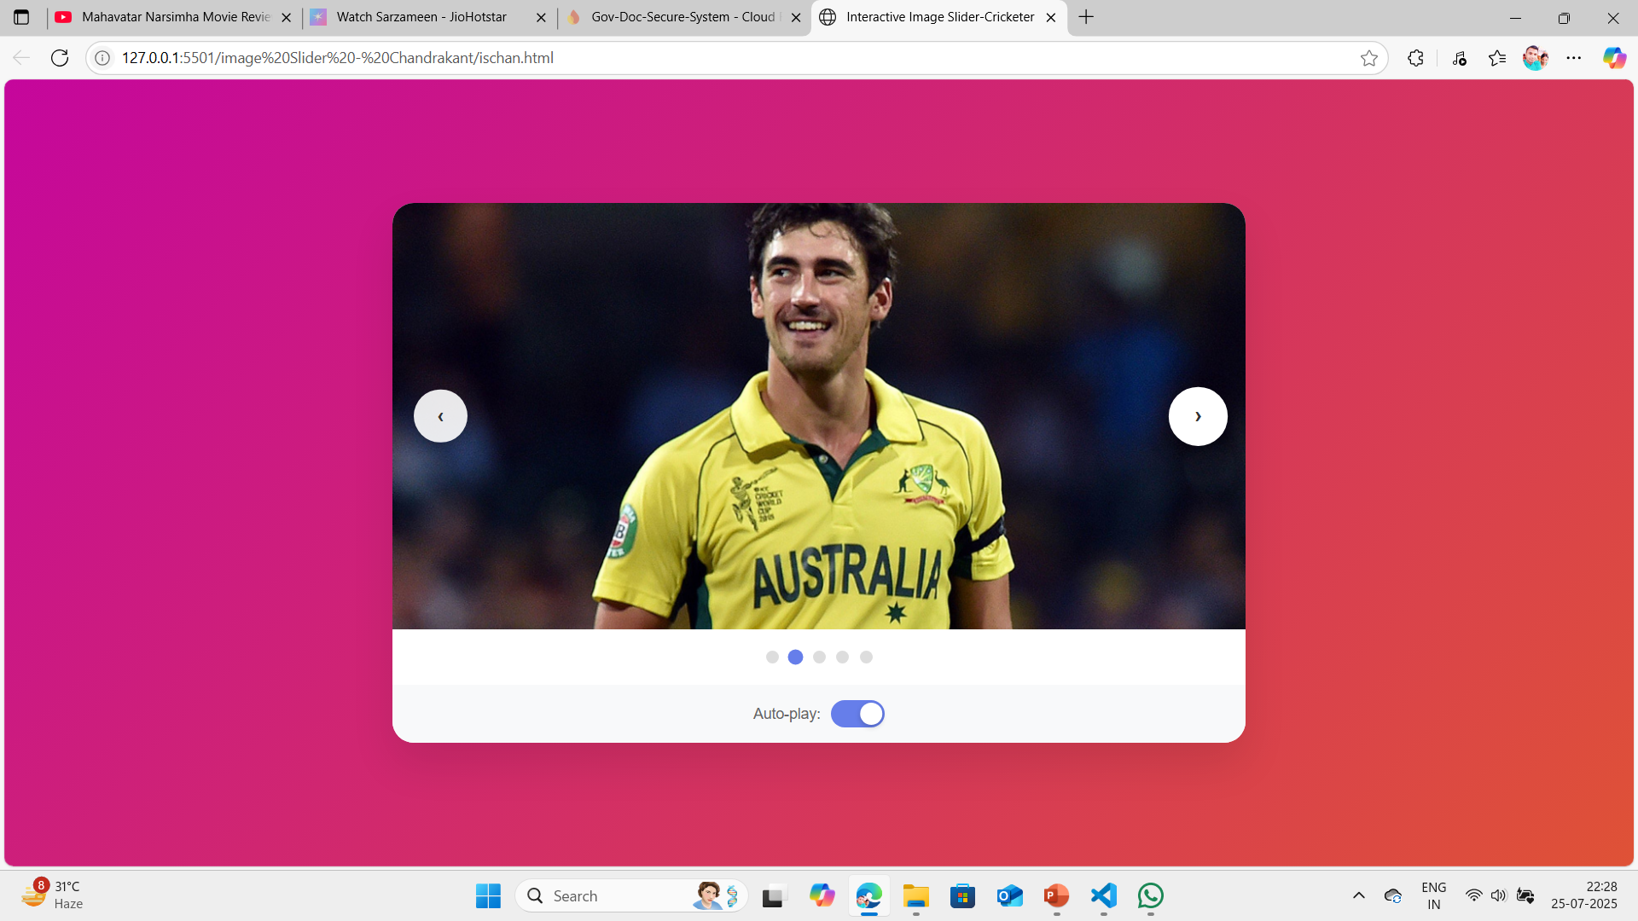
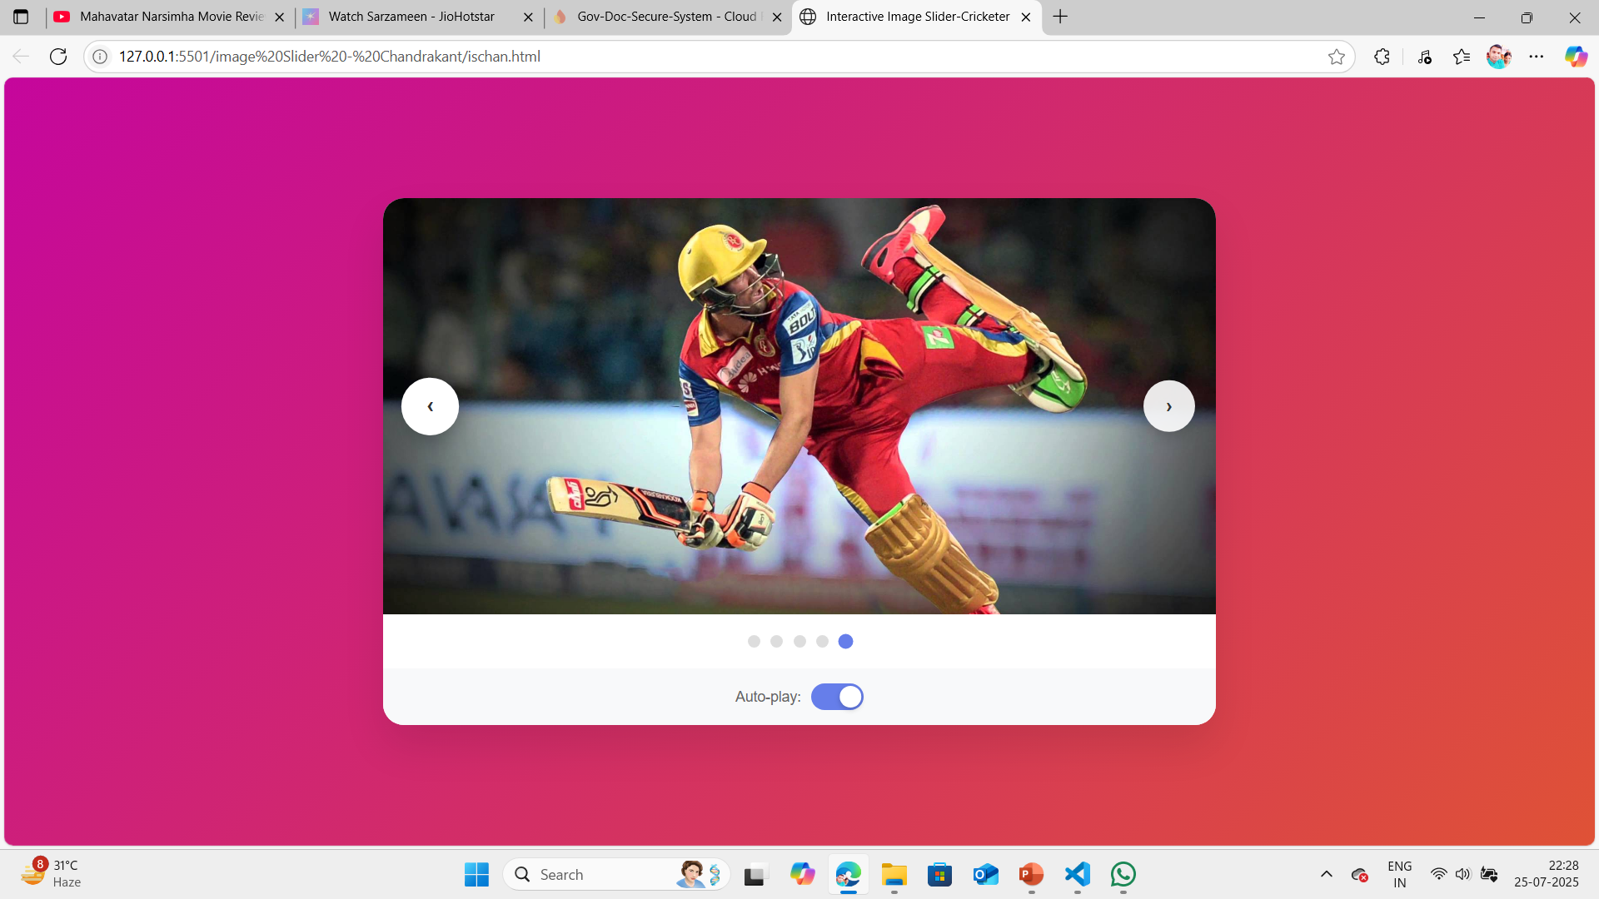
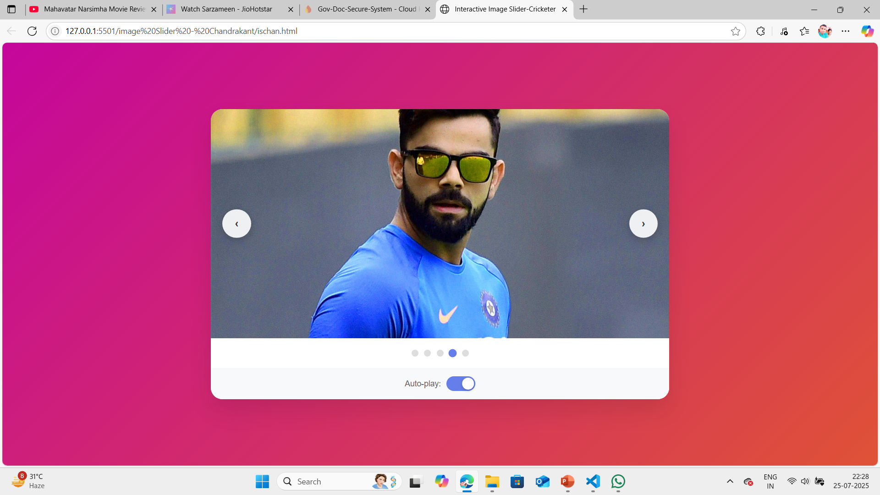
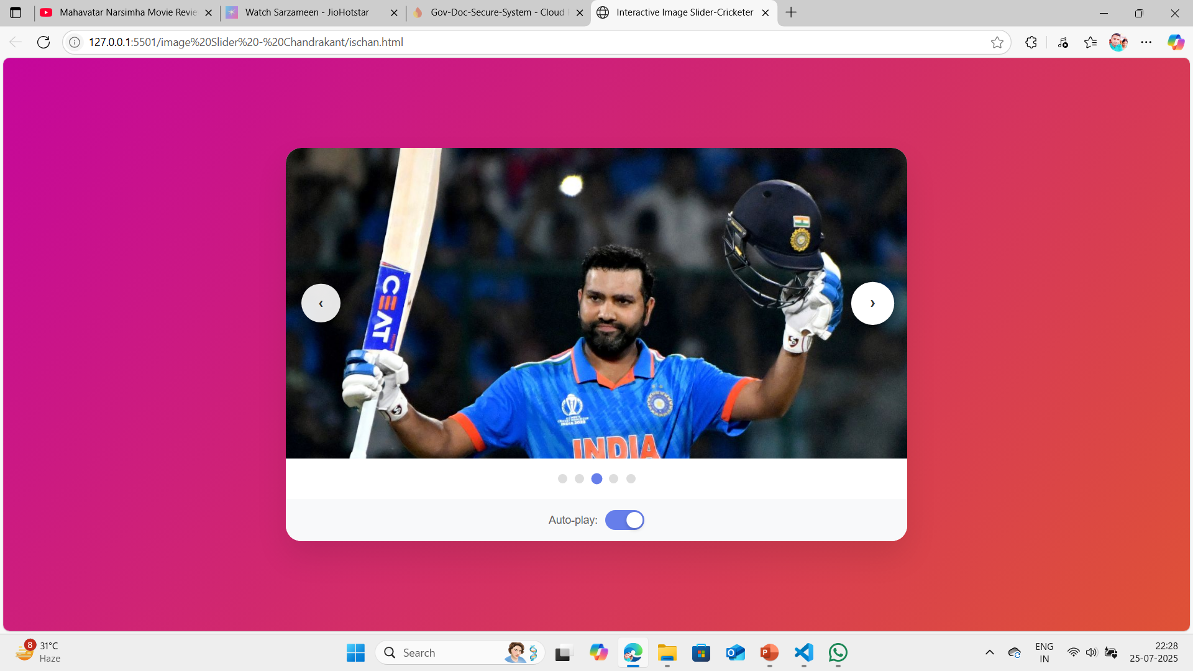
PROJECT 2 : Image Slider
Including screenshots and explanation

Slide 8
(BASIC )Project 3 -Interactive quiz ABSTRACT EXPLAINATION
1)Progress Tracking: Displays the current question number and a progress bar to show quiz completion status. 2)Timer: Each question has a 30-second timer; if time runs out, a random answer is selected, and the quiz proceeds to the next question.
3)Hints: Users can view a hint for the current question .
4)Navigation: Includes "Previous" and "Next" buttons for navigating .
5)Results Display: Shows the final score, a performance message, and detailed results indicating correct/incorrect answers. Restart Option: Allows users to restart the quiz from the beginning.
Open index.html in a web browser. No additional server setup .
Notes
The quiz automatically starts when the page loads. If the timer expires, a random answer is selected, and the quiz proceeds to the next question. The quiz is designed to be accessible and user-friendly, with hover effects, smooth transitions.
images from question 1 to ques 5 and ans and score
GITHUB LINK : https://github.com/chandrakant131103/interactive-quiz-Unified-Mentor-UM-

Slide 9
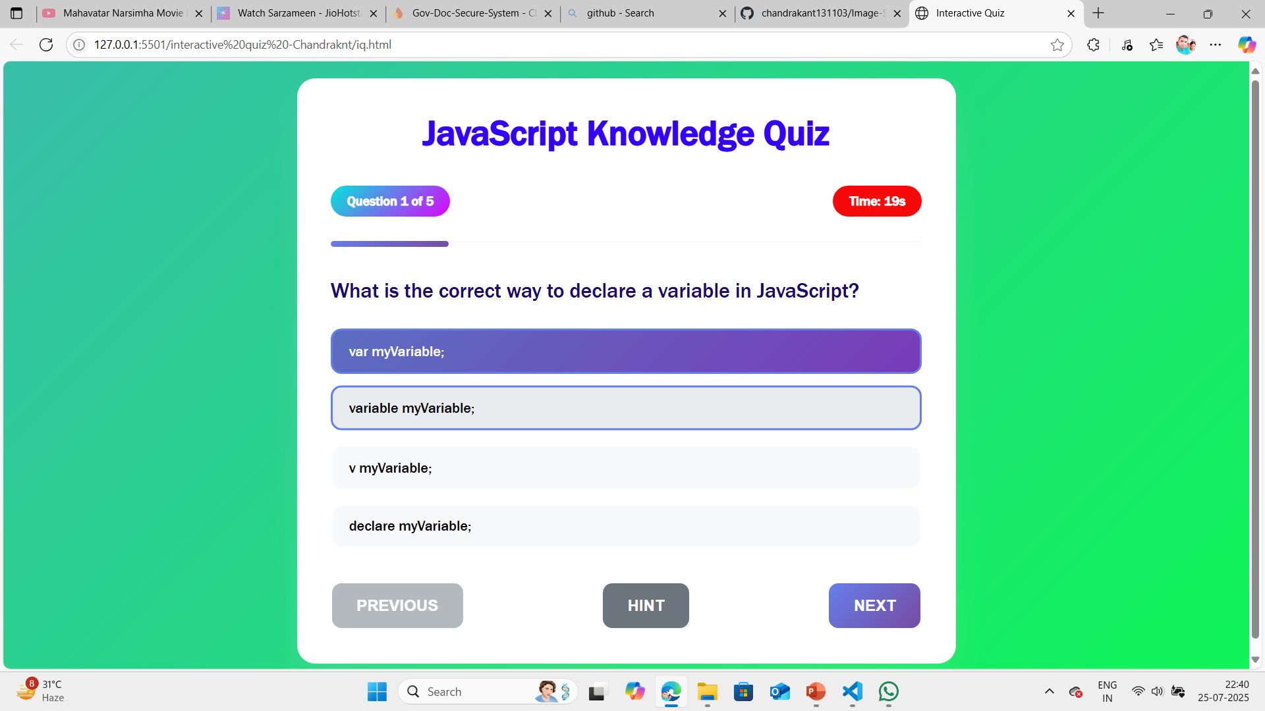
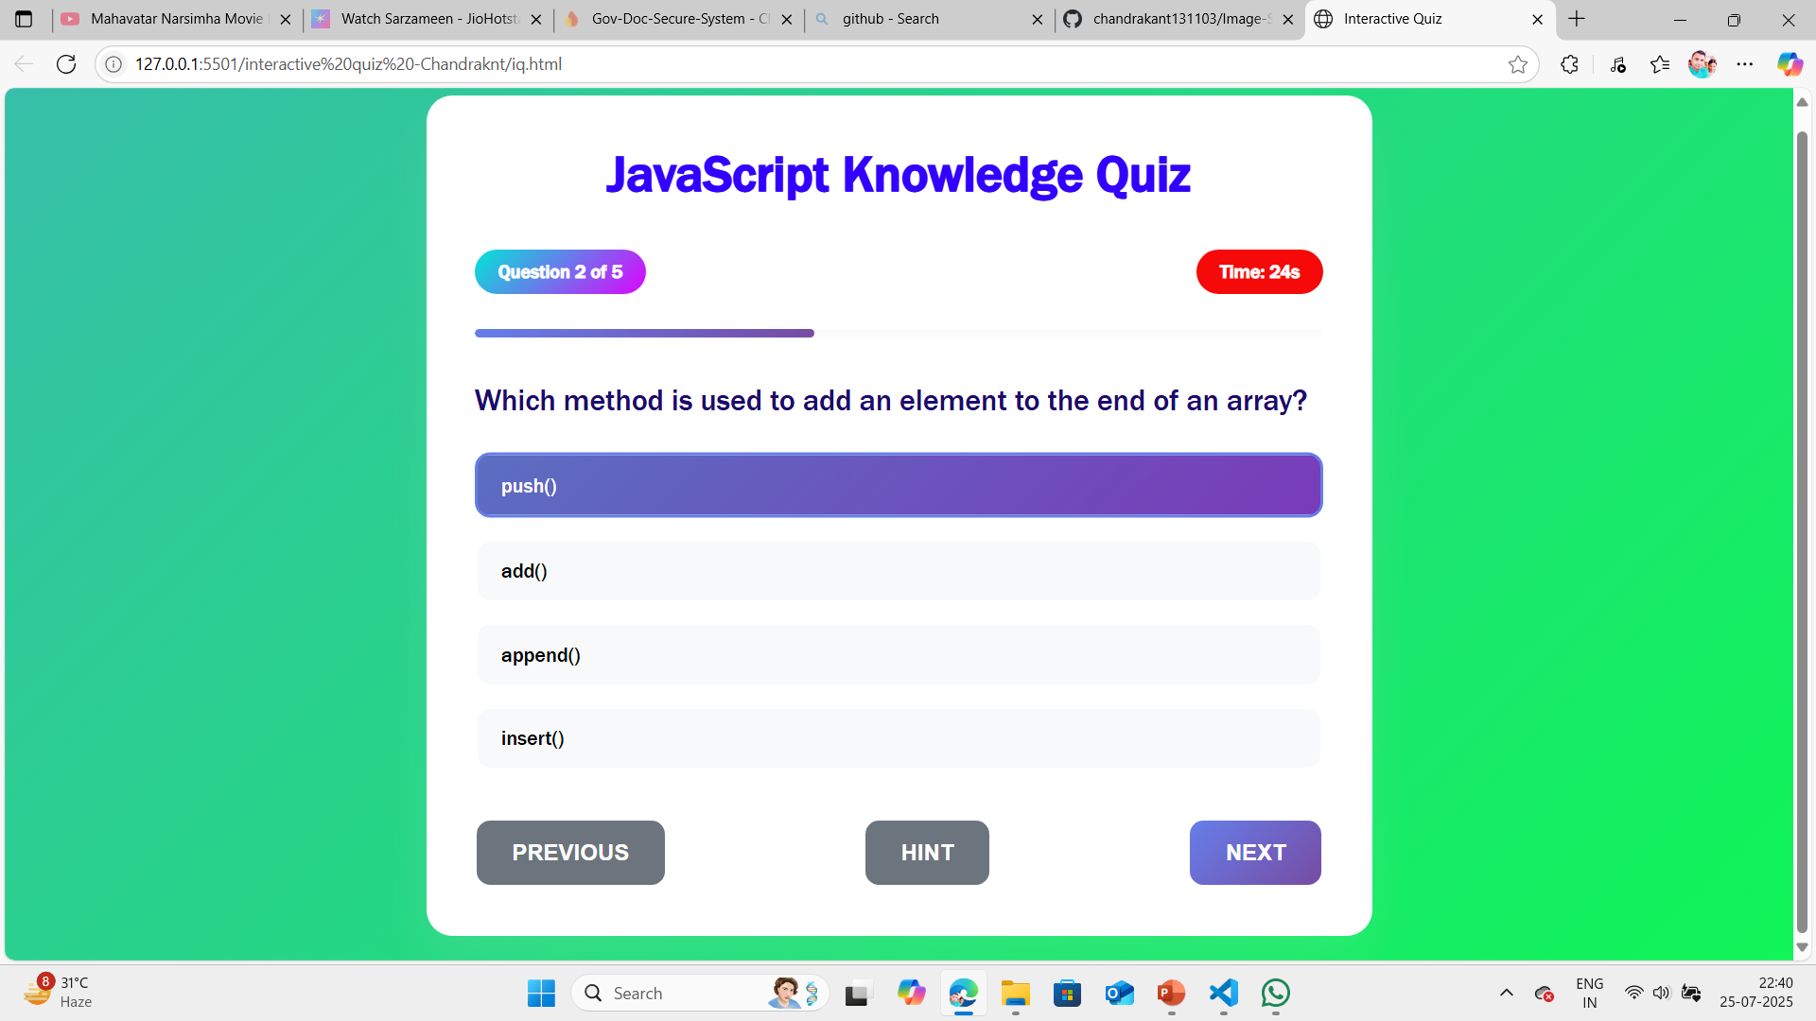
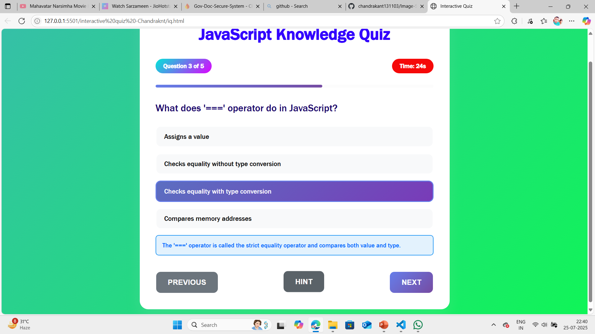
PROECT – INTERACTIVE QUIZ SCREENSHOT
a) Image from Question 1 to question 3

Slide 10
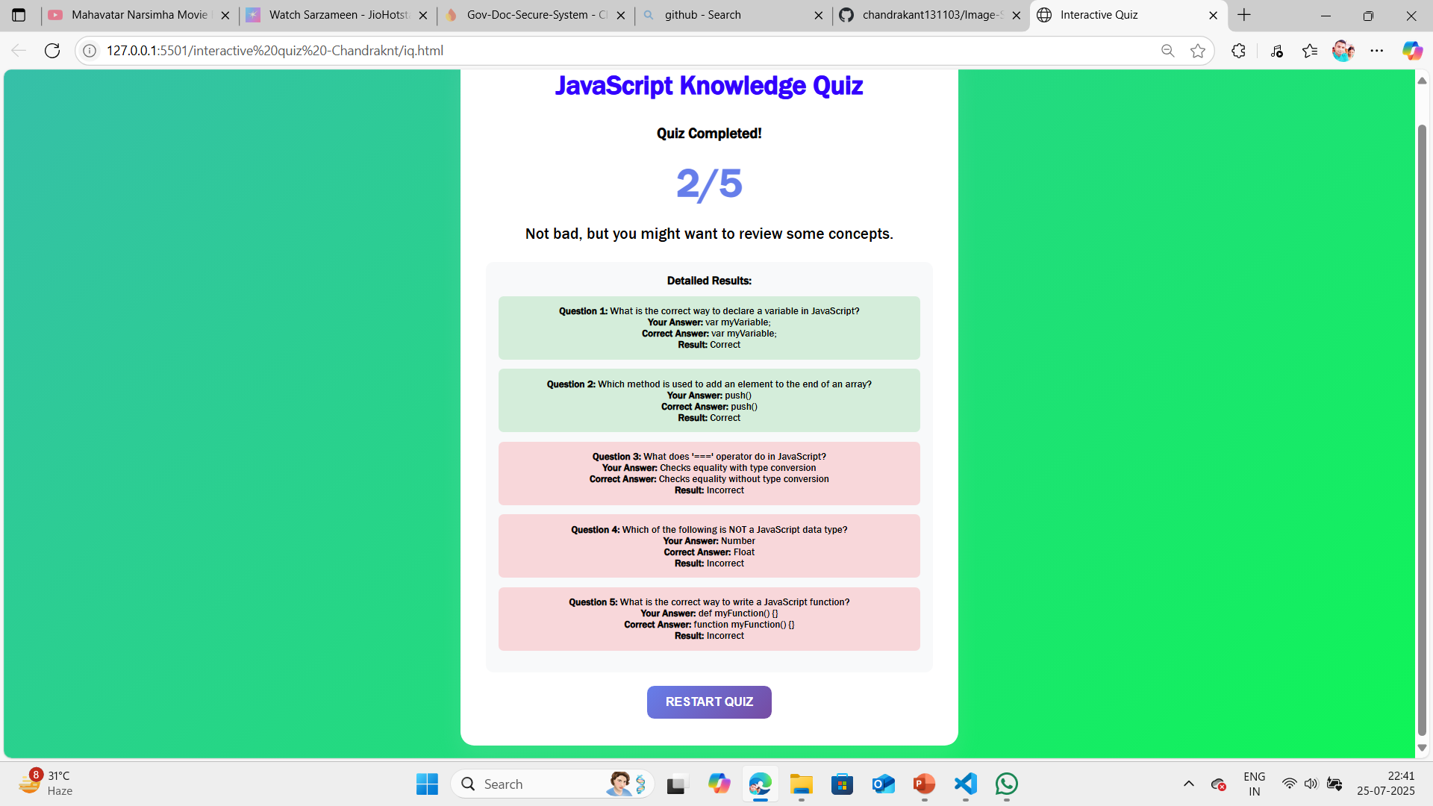
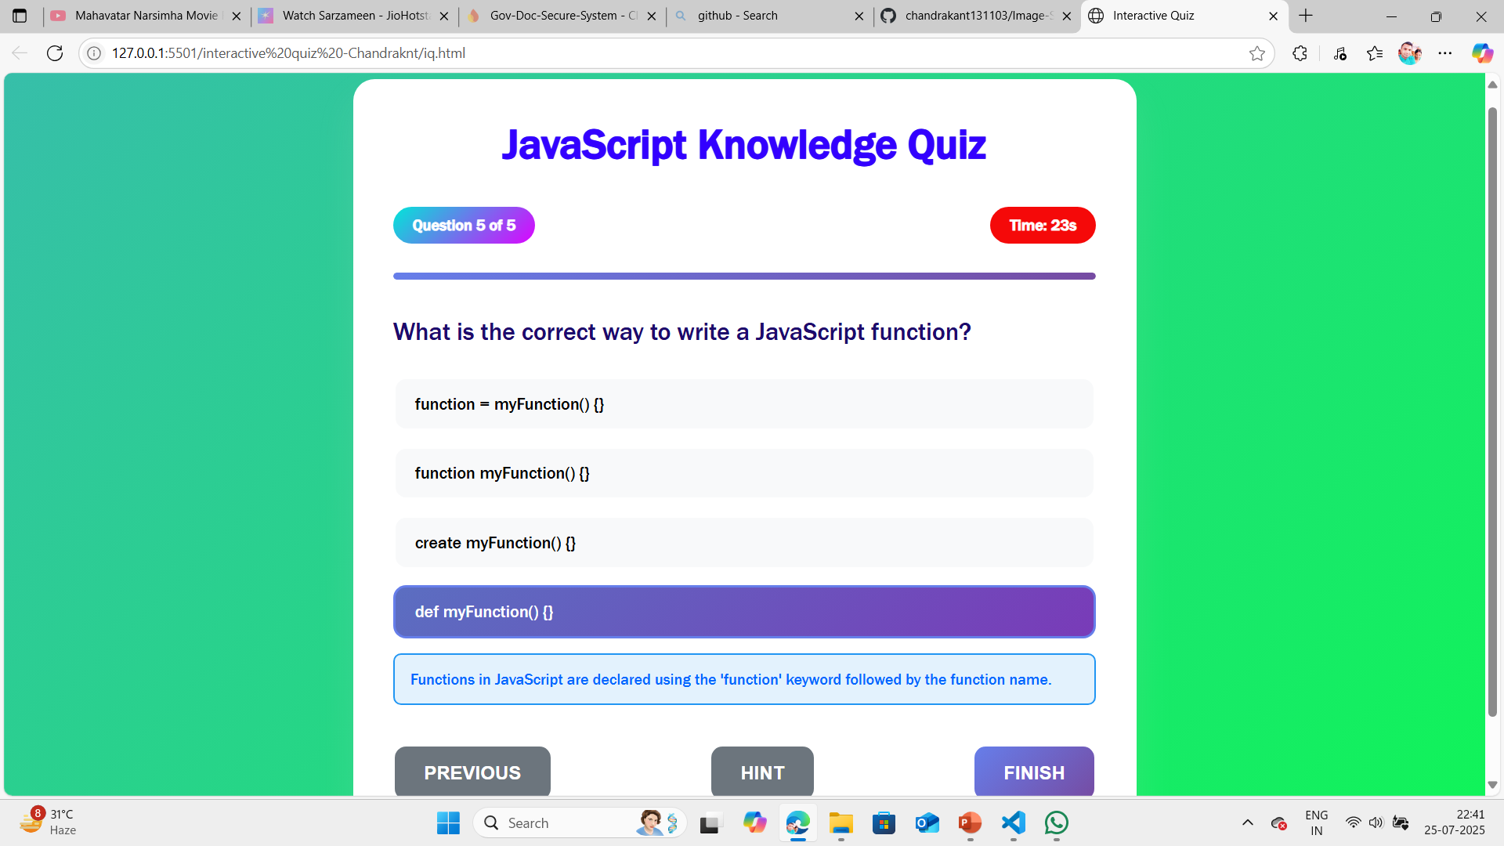
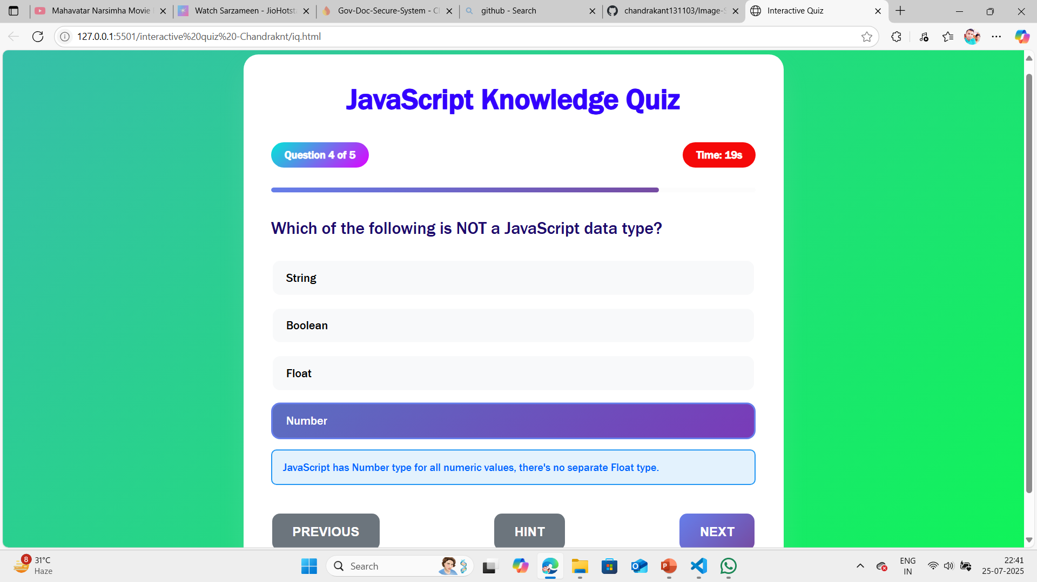
PROECT – INTERACTIVE QUIZ SCREENSHOT(..CONTINUED)
b) Question 4 and Question 5 along with Detailed Result

Slide 11
(BASIC)Project 4 -Interactive Infographics ABSTRACT EXPLAINATION
Project Documentation: Interactive Infographic Topic and Data The infographic focuses on Global Renewable Energy Consumption from 2010 to 2020, covering solar, wind, hydro, and bioenergy sources.
Chart.js Integration: Loaded via CDN to avoid local dependencies. The bar chart is configured with custom colors for each energy source and a y-axis starting at zero for accurate representation. Data Management: Data is stored in a JavaScript object for easy access and updates. The updateChart function dynamically regenerates the chart based on the selected year. Tooltip Implementation: Chart.js's built-in tooltip feature is customized to display energy consumption in TWh, providing clear additional information. Animation: Chart.js animations (1-second duration with easeOutQuad) make transitions smooth and visually appealing. Testing: The infographic was tested on Chrome, Firefox I have used charts for cdn as it is free to use library
Open index.html in a browser. Use the dropdown to select a year (2010, 2015, or 2020). Hover over the chart bars to view consumption data. The infographic adapts to your device's screen size automatically
GITHUB LINK : https://github.com/chandrakant131103/Interactive-Infographics-Unified-Mentor-UM-

Slide 12
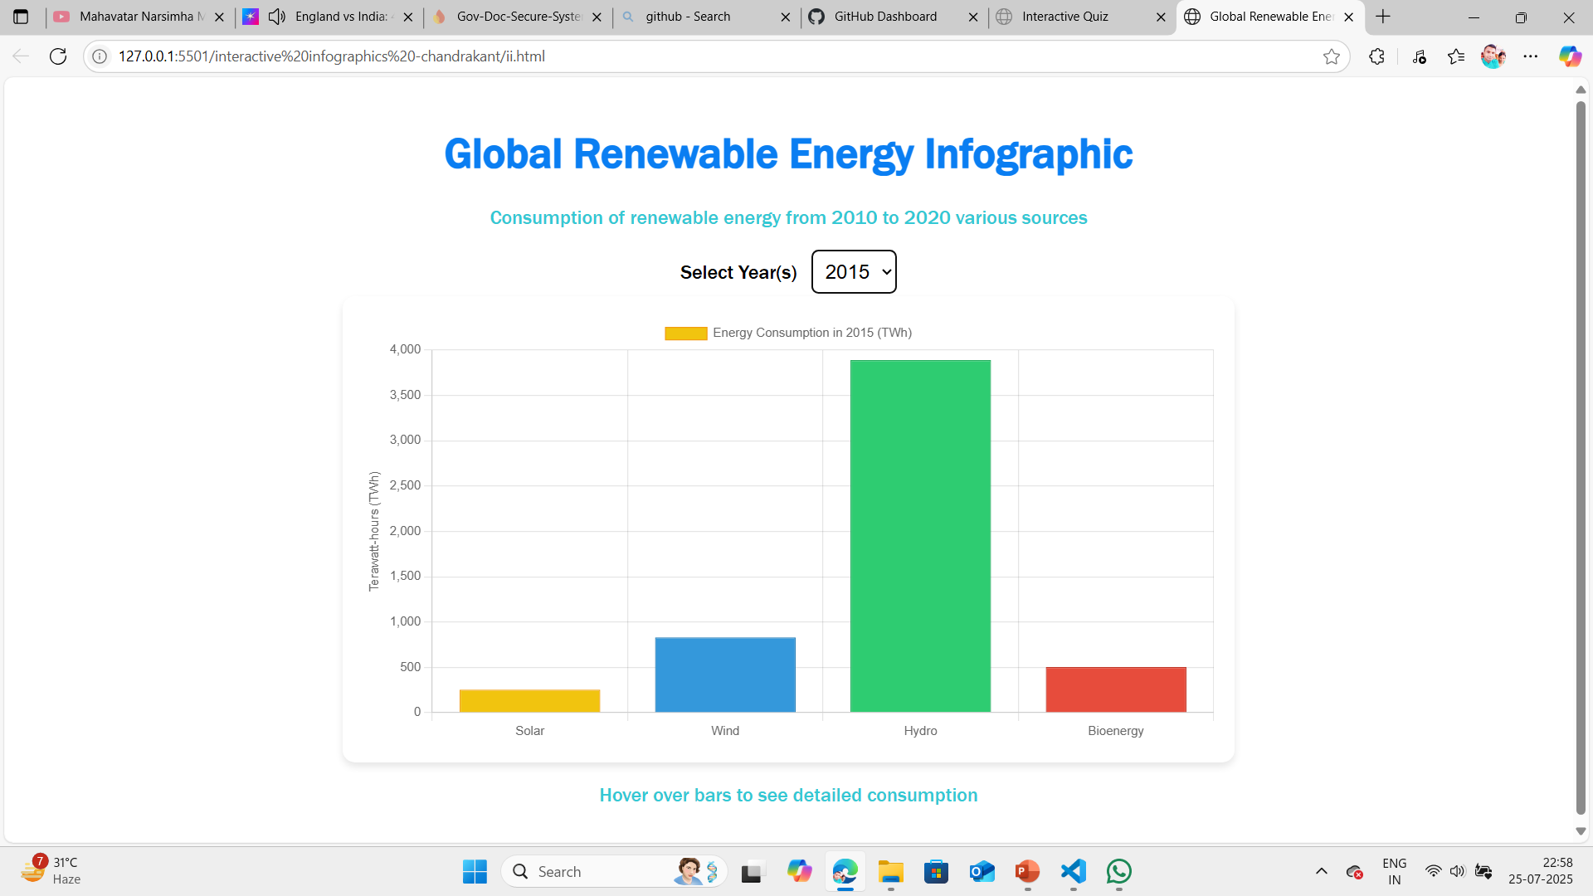
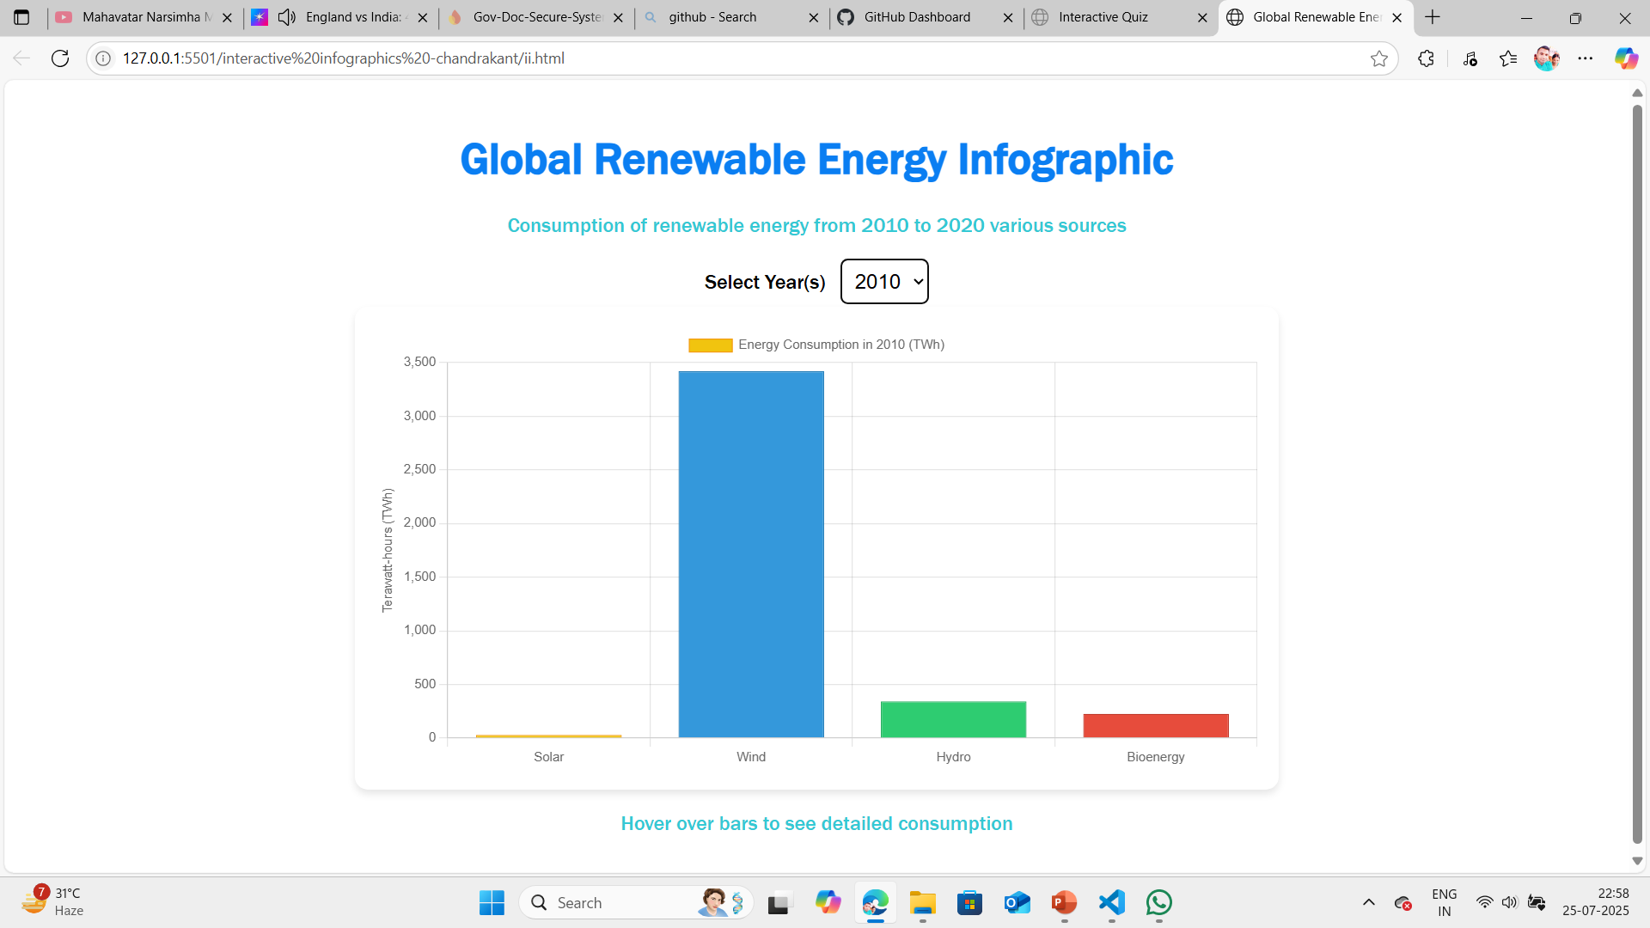
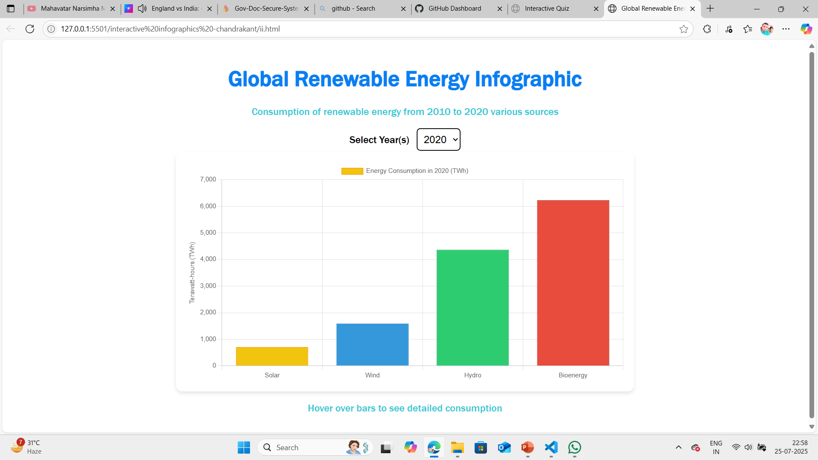
(BASIC)Project 4 -Interactive Infographics SCREENSHOT

Slide 13
(ADVANCED) Project - Secure & Share Govt Document with Family ABSTRACT EXPLAINATION
Government Document Sharing Portal Securely Store & Share Official Documents with Family using HTML, CSS, JavaScript, and Firebase.
Introduction The Government Document Sharing Portal is a web-based application designed to provide users with a secure and convenient way to store and share their important government documents online. Taking inspiration from platforms like DigiLocker, this system utilizes modern web technologies to ensure privacy, security, and ease of access to personal documents.
Key Functionalities Secure Document Upload: Users can safely upload and manage their government-issued documents in a protected environment.
Document Sharing with Permissions: Share your documents with trusted family members or organizations by providing their email IDs.
User Login & Registration: A robust authentication mechanism powered by Firebase ensures only authorized access.
Mobile-Friendly Interface: The application is fully responsive, providing an optimal user experience across desktops, tablets, and smartphones.
Tech Stack Frontend: HTML, CSS, JavaScript
GITHUB LINK : https://github.com/chandrakant131103/Government-Document-Sharing-Portal-Unified-Mentor-UM-
Backend & Services: Firebase Authentication, Firestore Database, Firebase Storage
How It Works Uploading Documents: Users can upload digital copies of their government documents directly into their secure account.
Accessing Documents: A document library is provided where users can view and manage their uploaded files.
Sharing Files Securely: Documents can be shared by entering the recipient’s email. The system ensures that only the designated recipient can access the shared documents.
Link of web : https://neon-hummingbird-3ec4fa.netlify.app/

Slide 14
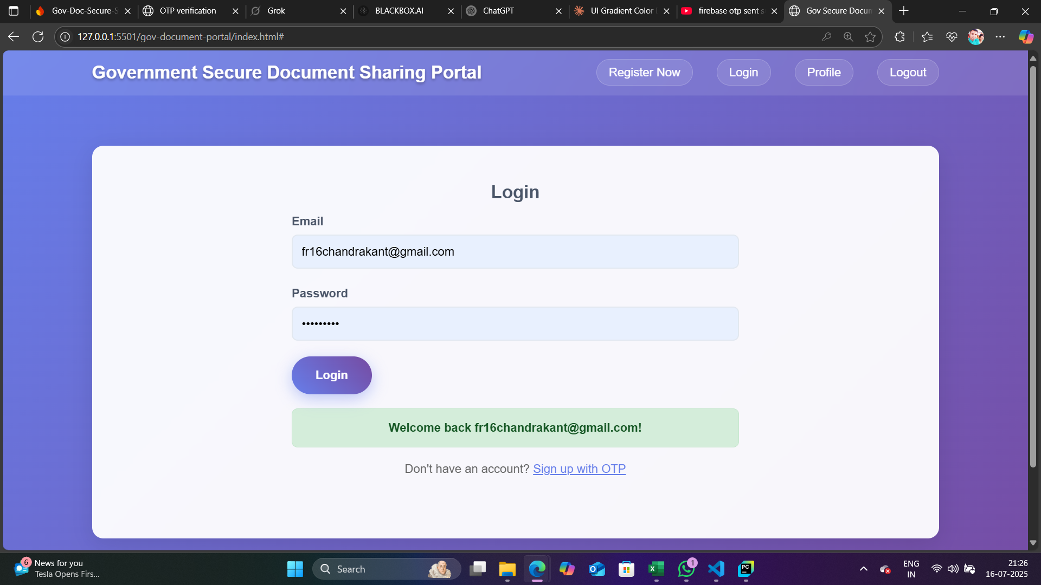
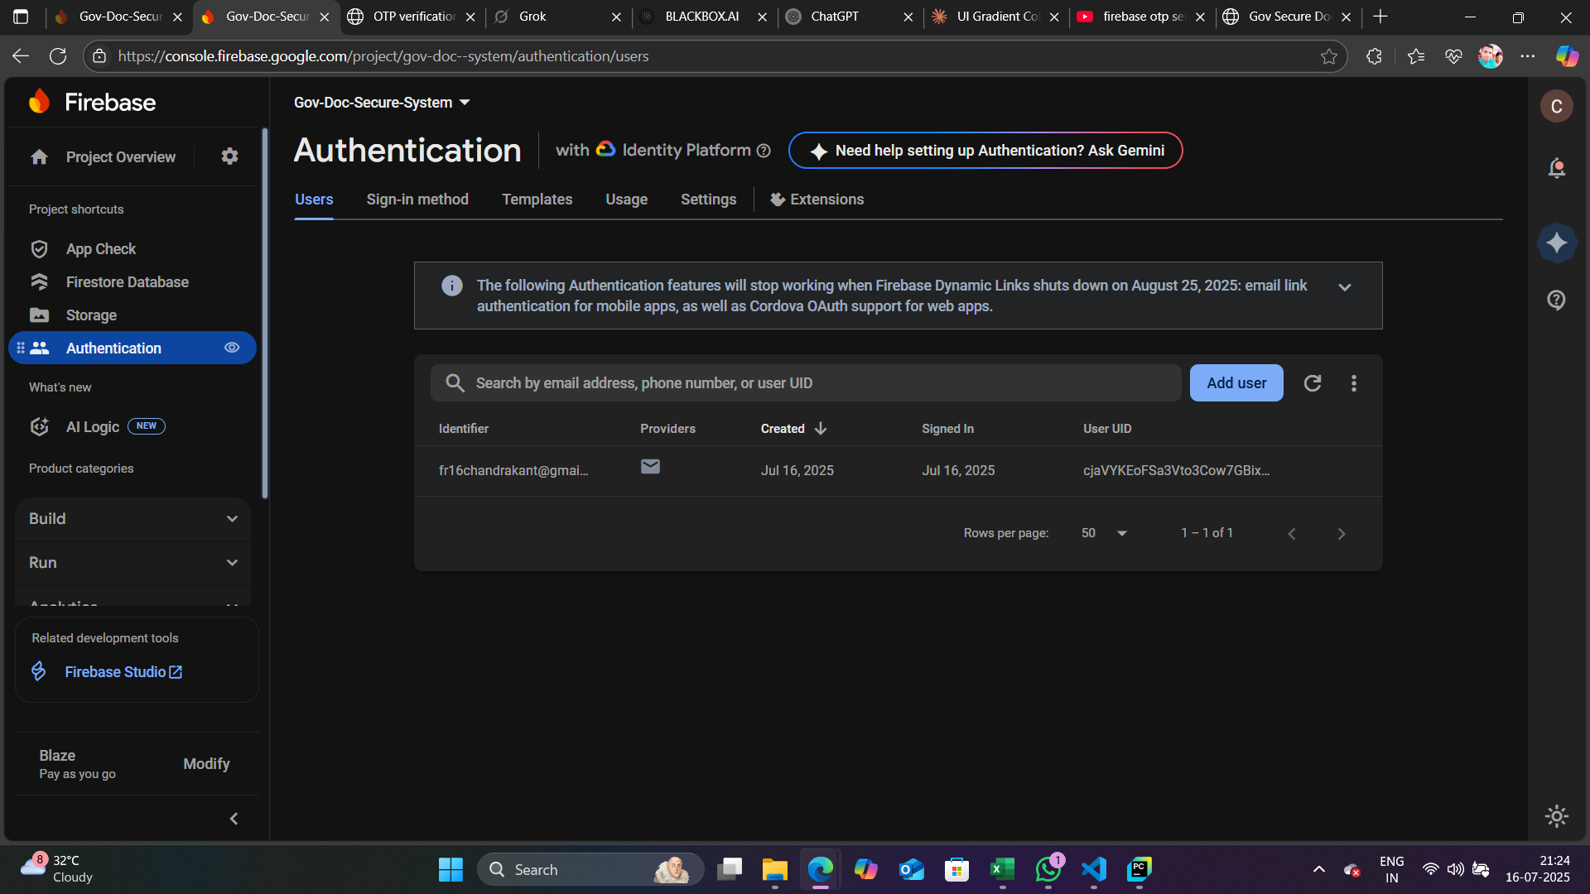
(ADVANCED) Project - Secure & Share Govt Document with Family SCREENSHOT
Register page and login

Slide 15
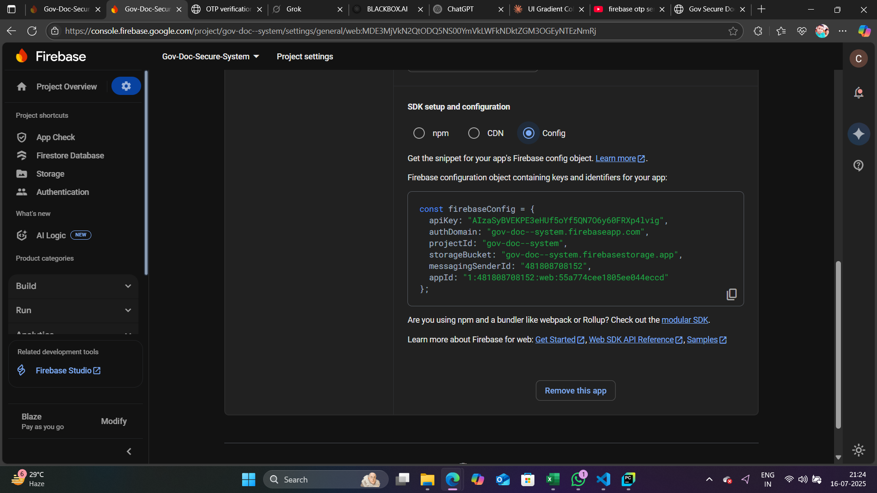
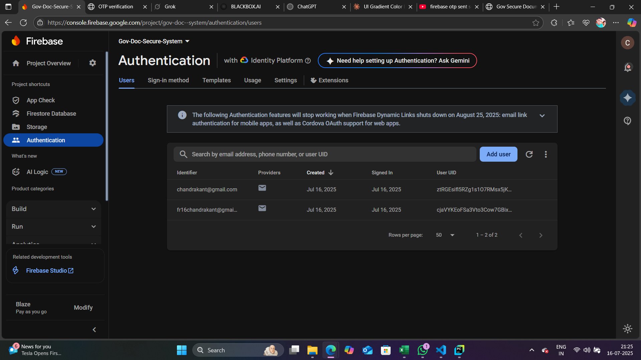
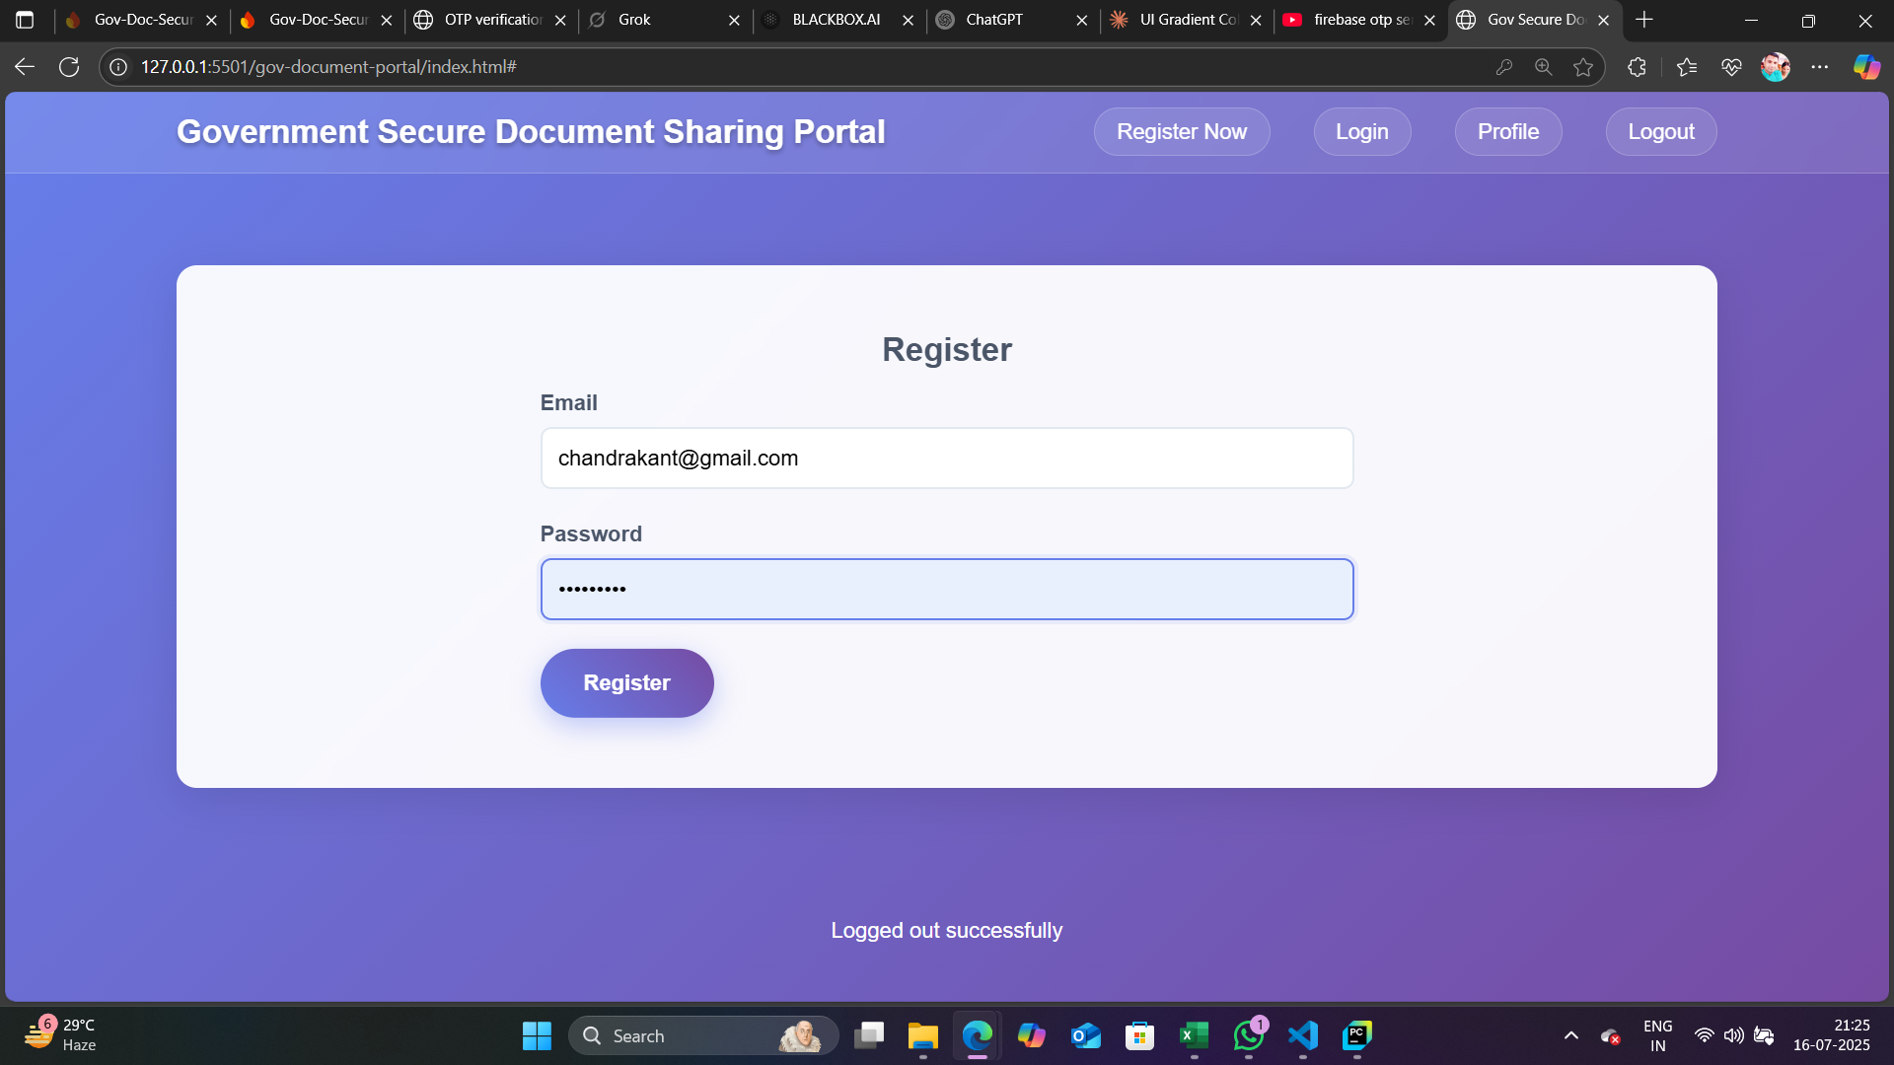
API KEY
AUTHENTICATION
REGISTER PAGE AND AUTHENTCATION

Slide 16
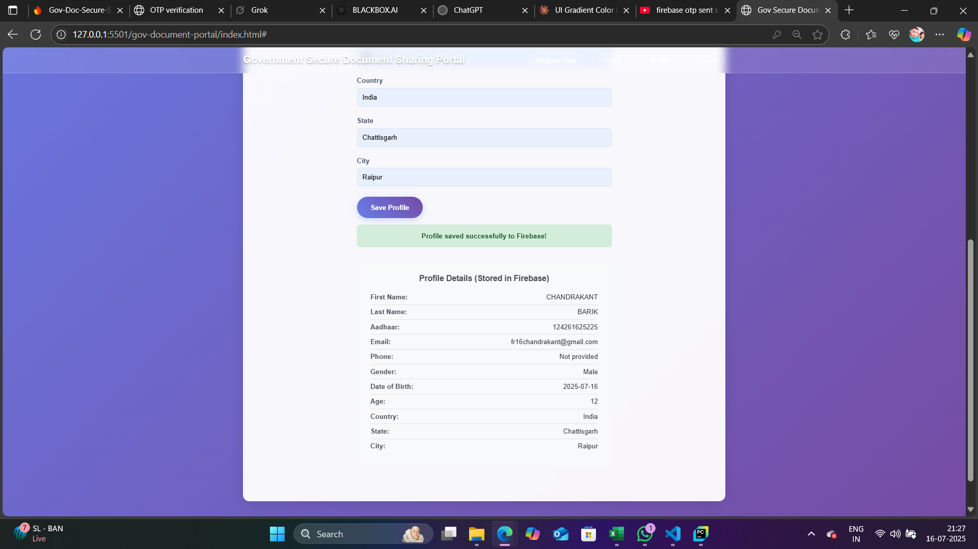
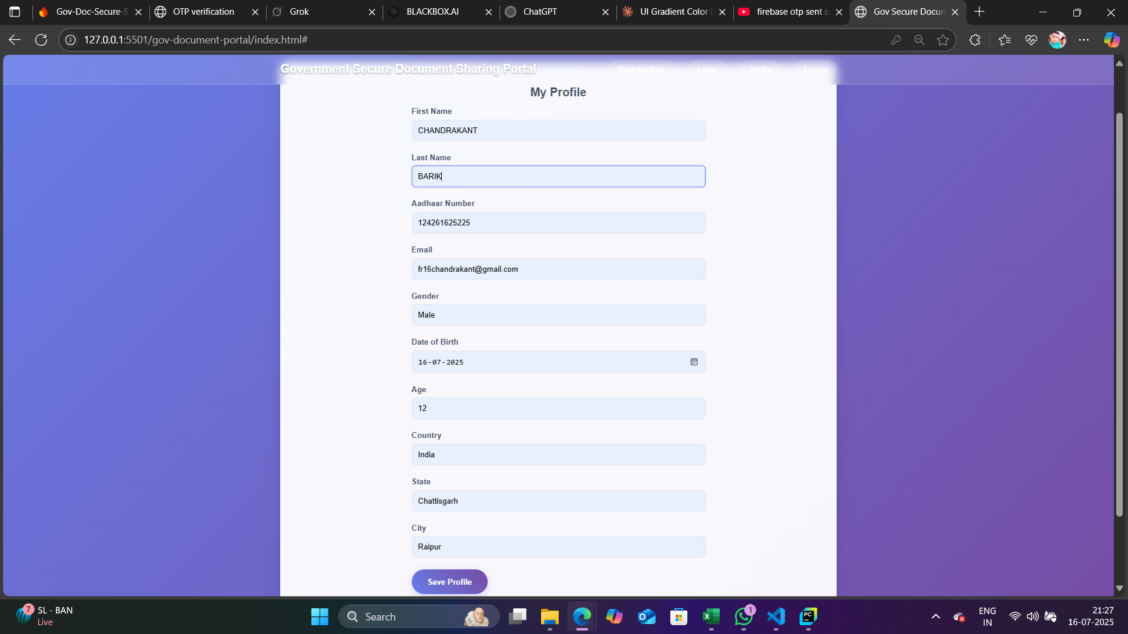
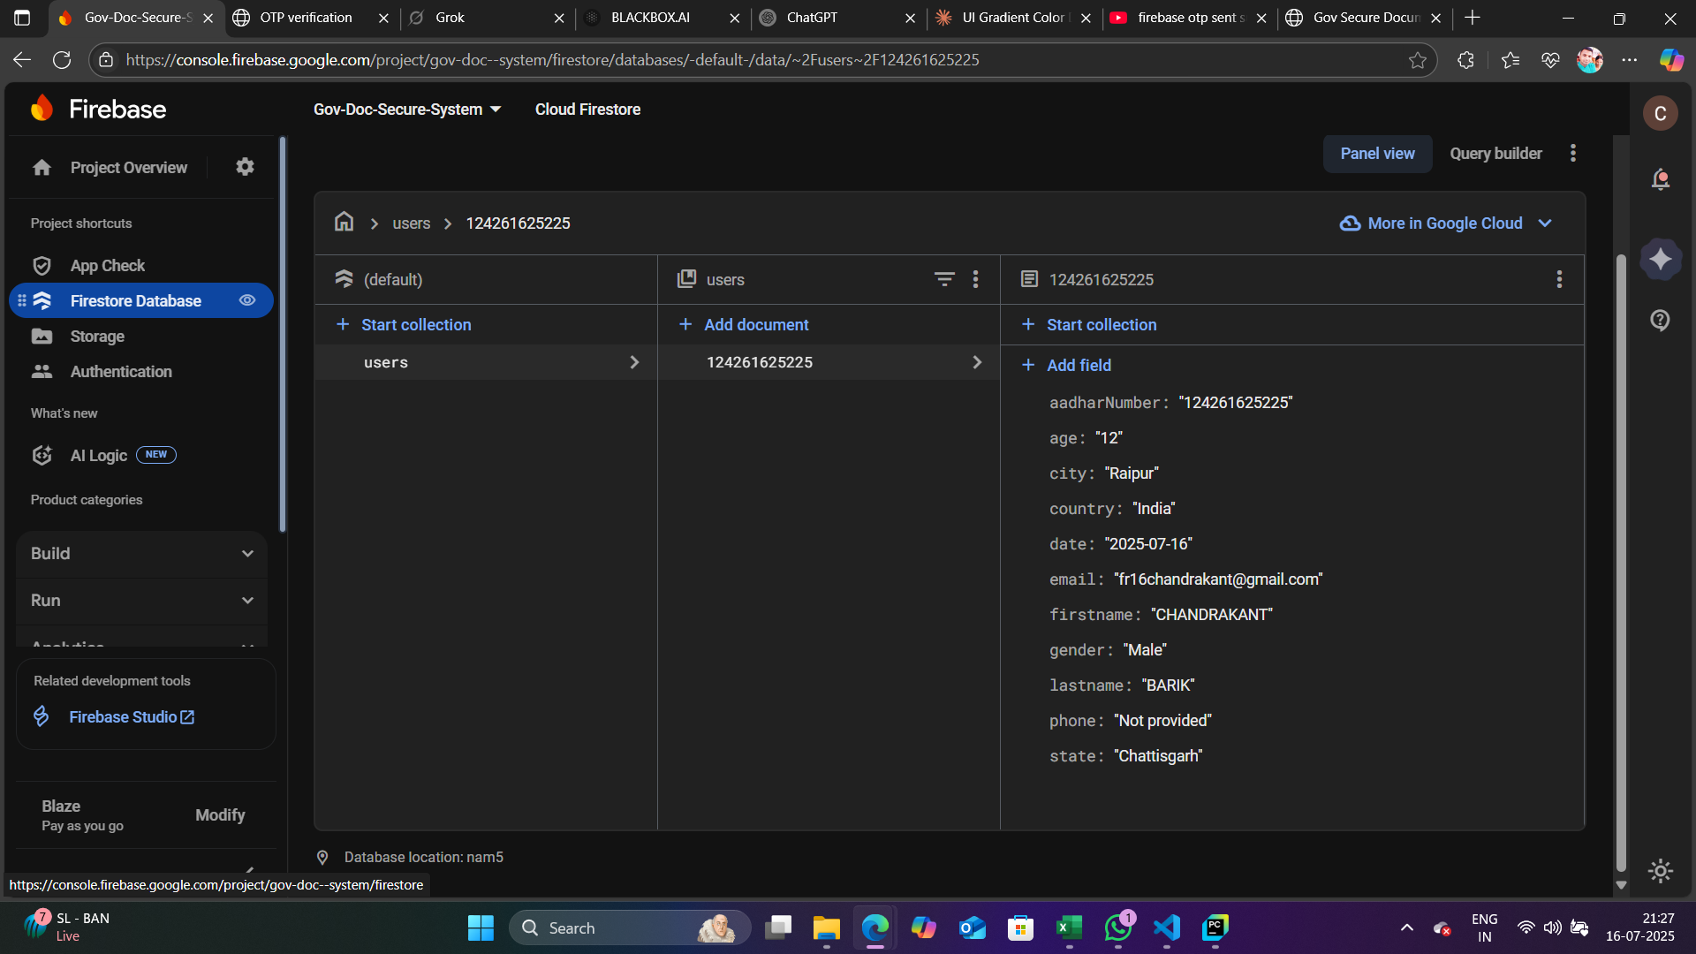
PROFILE Login AND REGISTER TO FIRESTORE DATABASE

Slide 17
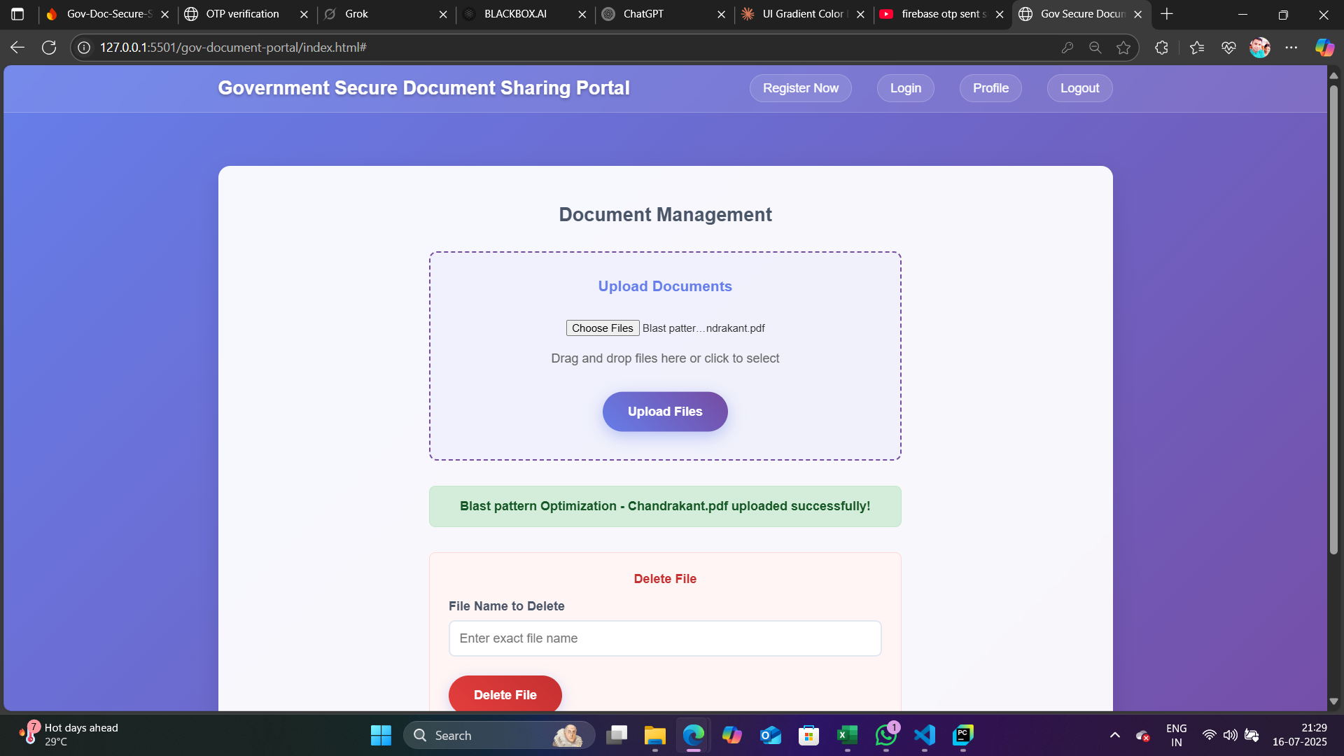
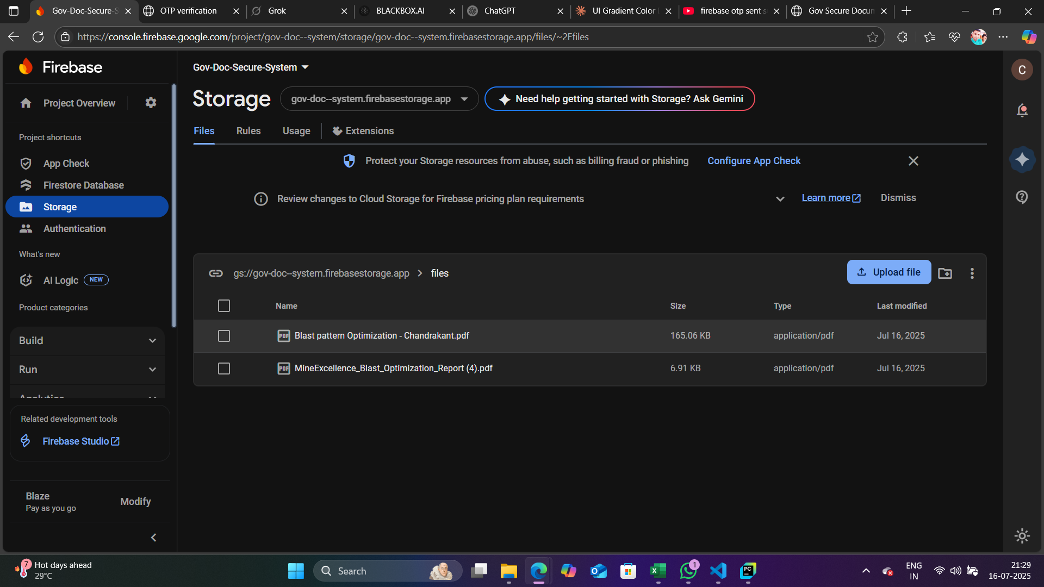
DOCUMENT UPLOAD AND CONNECT AND STORE DATA IN STORAGE FIRESTORE

Slide 18
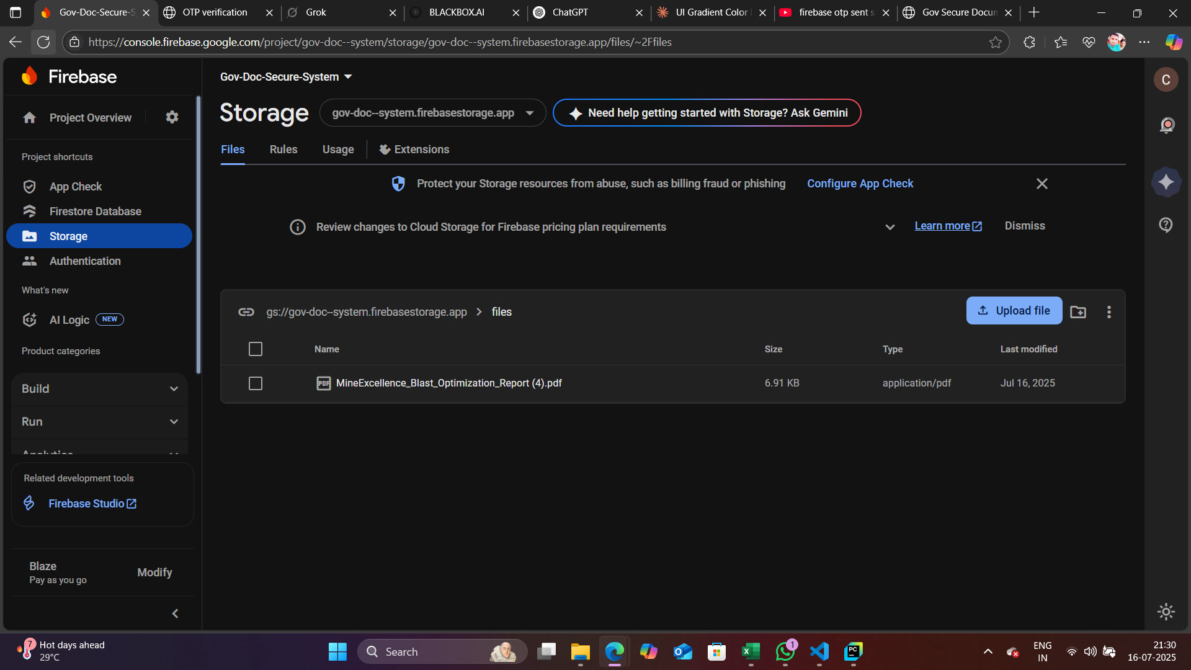
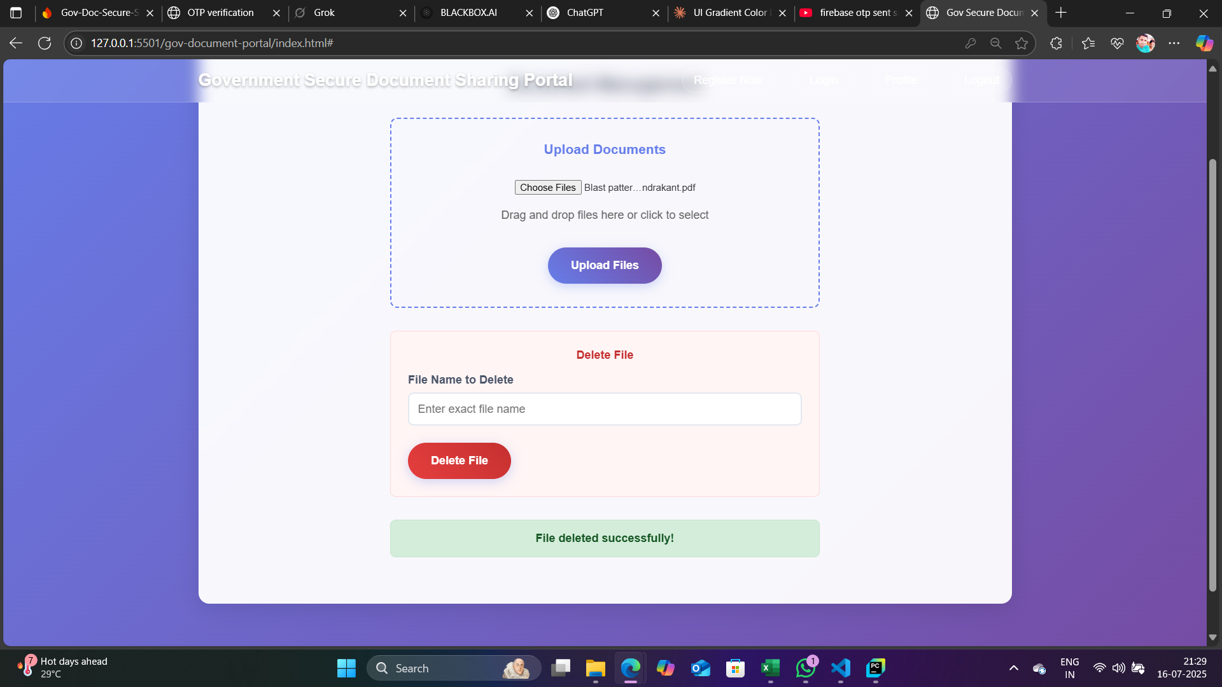
DOCUMENT DELETE

Slide 19
(ADVANCED) Project - Members Clinic Management System ABSTRACT EXPLAINATION
A comprehensive web-based healthcare application that streamlines clinic operations through dual-role authentication for doctors and receptionists. The system digitizes patient management, reduces paperwork, and improves care efficiency.
.
Patient Management: Registration with automatic token generation and real-time queue system
Prescription Handling: Electronic prescription creation and management
Billing Operations: Automated invoice generation with PDF creation and cloud storage
Role-Based Access: Separate interfaces for doctors (patient queue, prescriptions) and receptionists (registration, billing)
Real-time Updates: Live data synchronization across all operations
Technology Stack
Built with HTML5, CSS3, JavaScript frontend and Firebase backend (Firestore, Authentication, Storage). Uses jsPDF for bill generation.
Registration: Receptionist registers patients with auto-generated tokens
Consultation: Doctor selects patients from queue, creates prescriptions, sets fees
Billing: Receptionist generates PDF bills for completed consultations
Security & Features
Firebase authentication, role-based permissions, activity logging, responsive design, and comprehensive audit trails ensure secure, efficient clinic operations.
Live Demo: https://gregarious-naiad-8abe52.netlify.app/
GITHUB LINK : https://github.com/chandrakant131103/Clinic-Management-System---Unified-Mentor-UM-

Slide 20
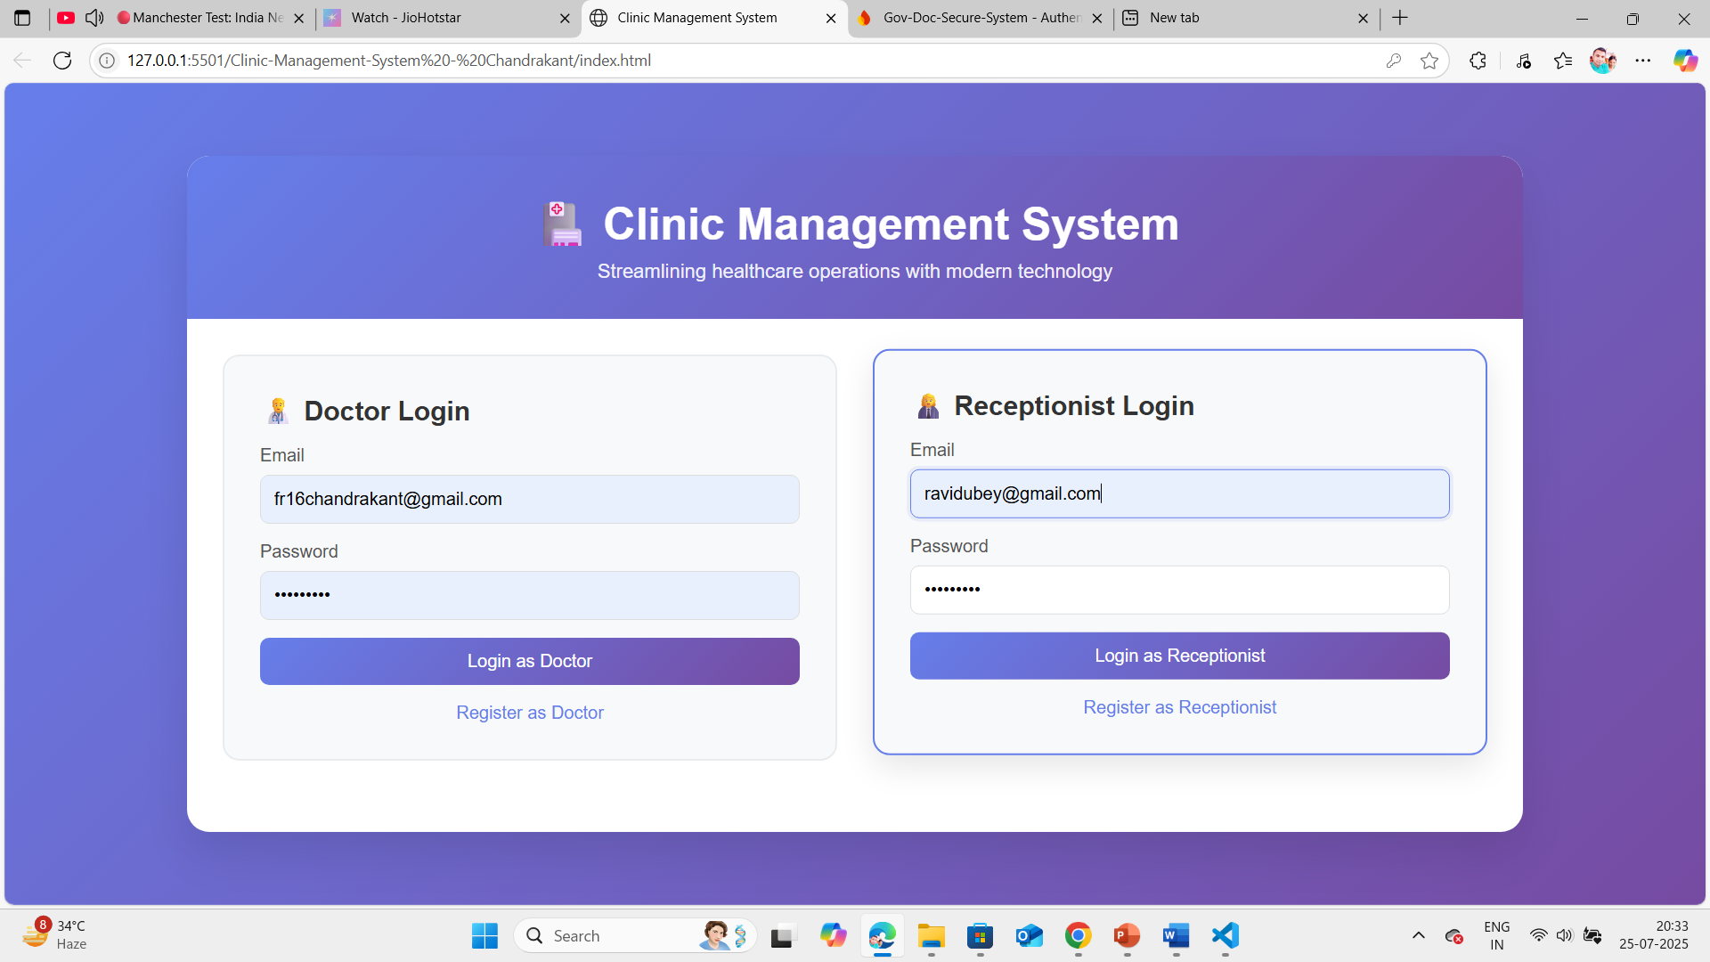
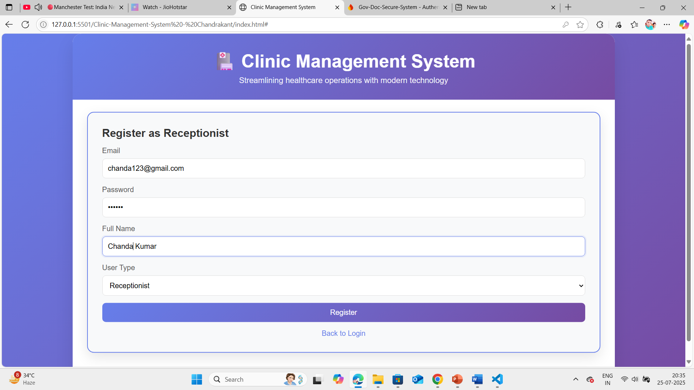
(ADVANCED) Project - Members Clinic Management System SCREENSHOT
Homepage
REGISTER AS RECEPTIONIST

Slide 21
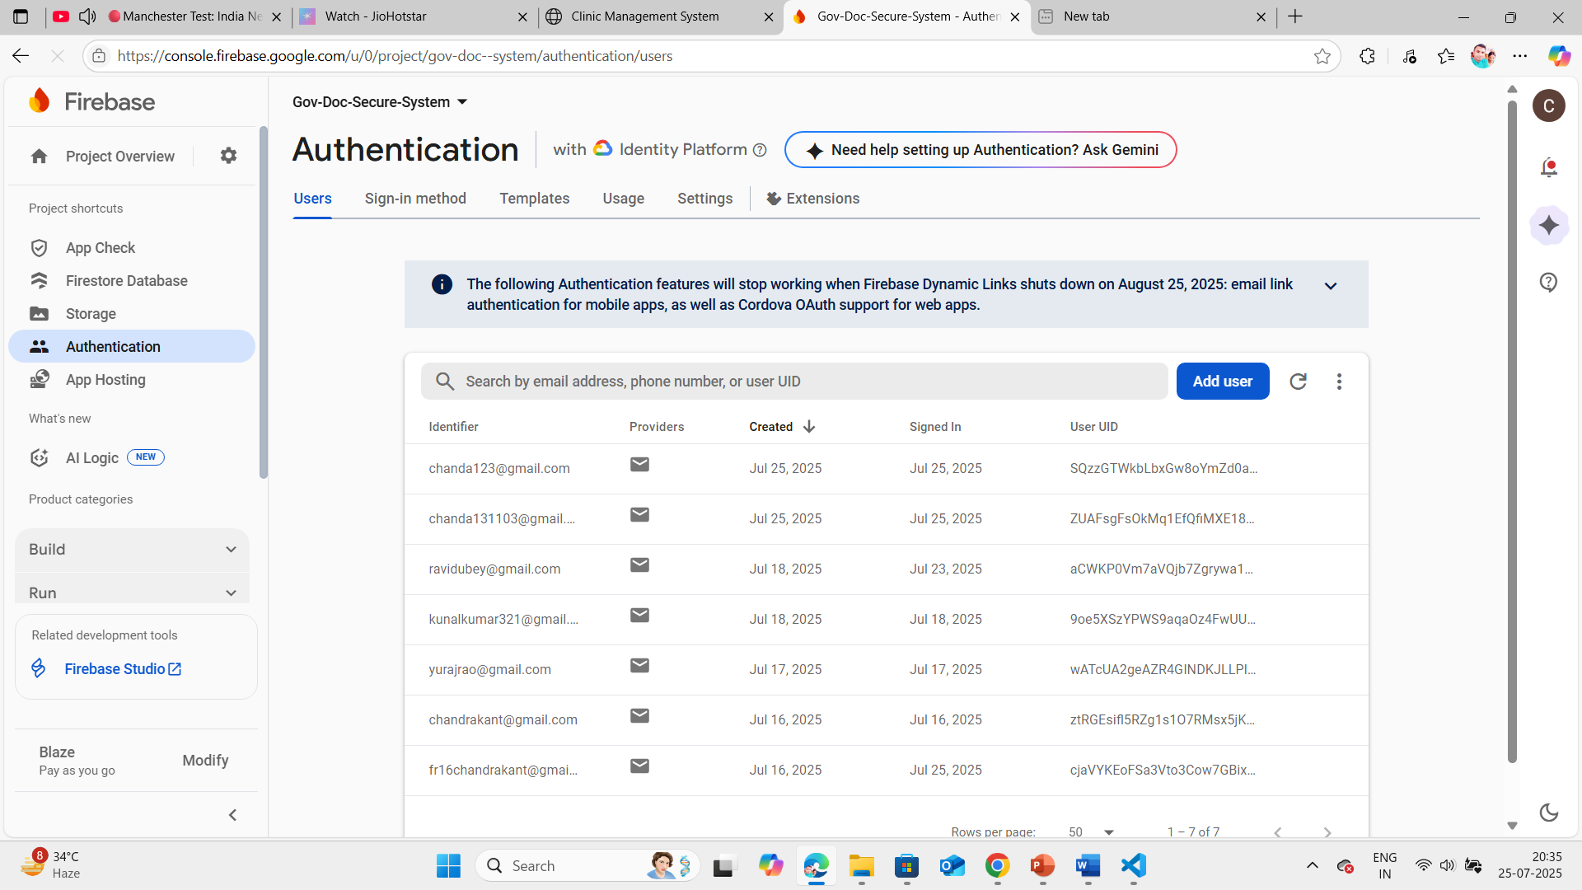
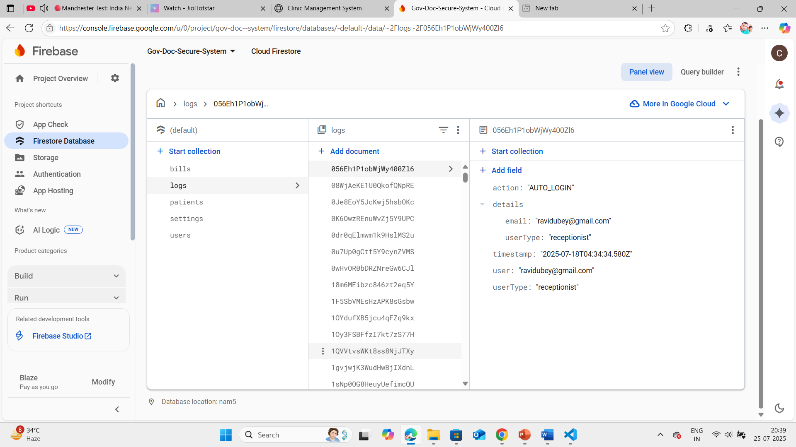
AUTHENTICATION CHECK
EVERY LOGIN WILL BE ENTERED IN DATA

Slide 22
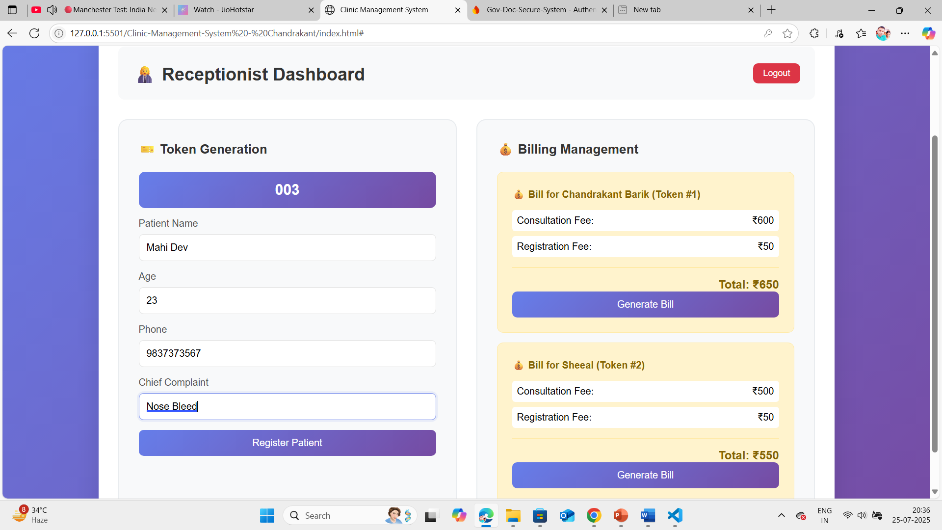
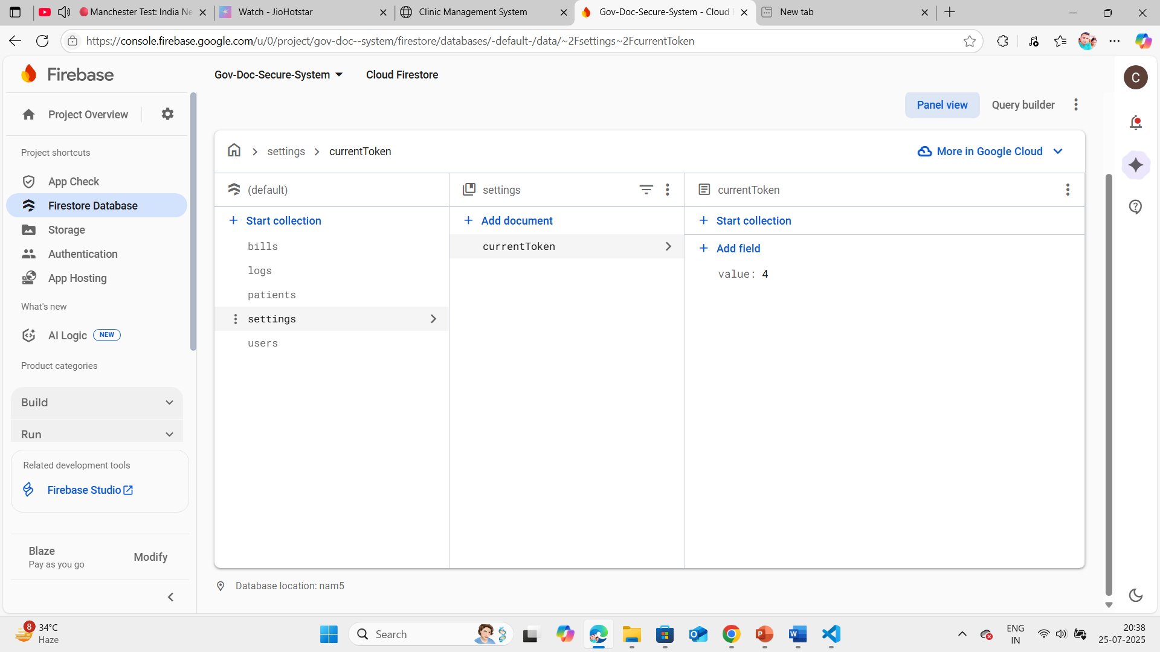
RECEPTIONIST DASHBOARD TOKEN GENRATION ,PATIENT REGISTRATION AND BILING MANAGEMENT
TOKEN CHECK IN FIREBASE DATABASE

Slide 23
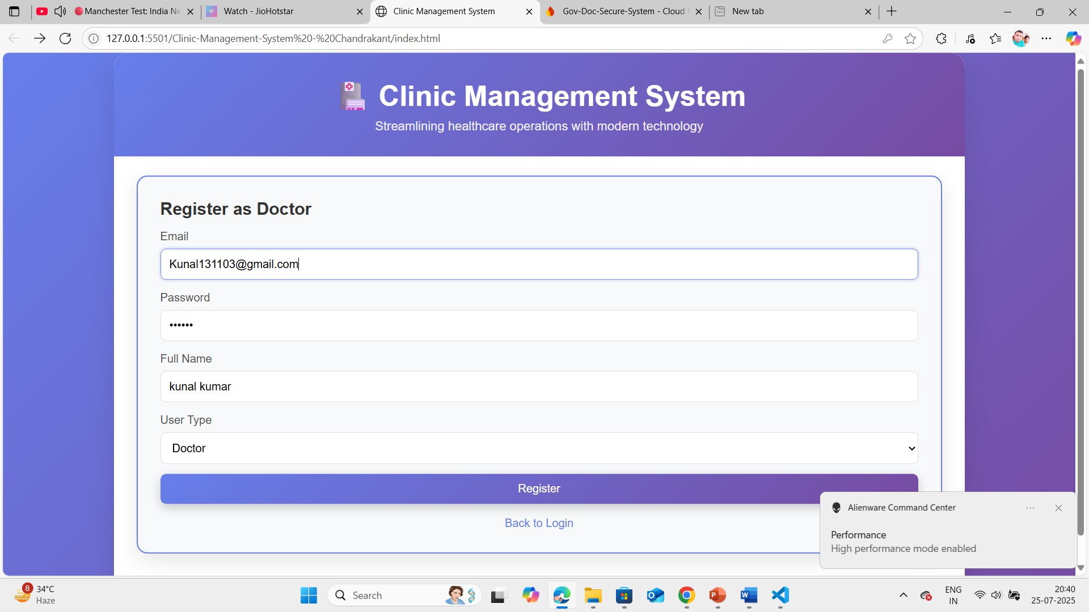
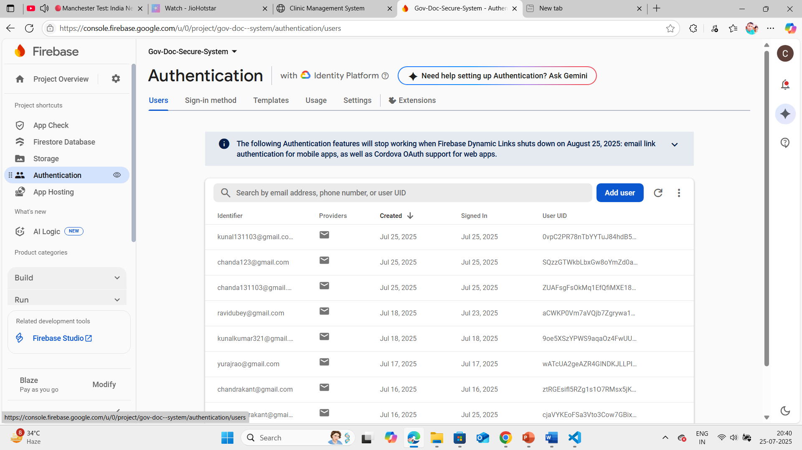
REGISTER AS DOCTOR AND AUTHENICATION CHECK

Slide 24
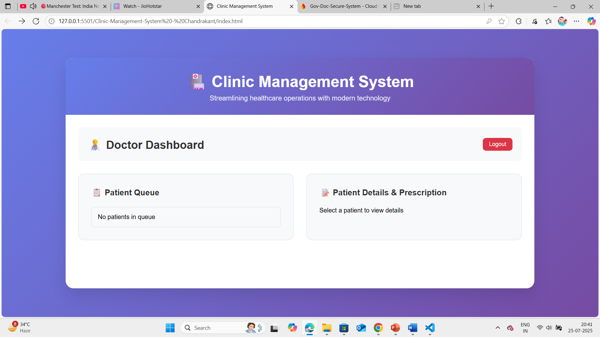
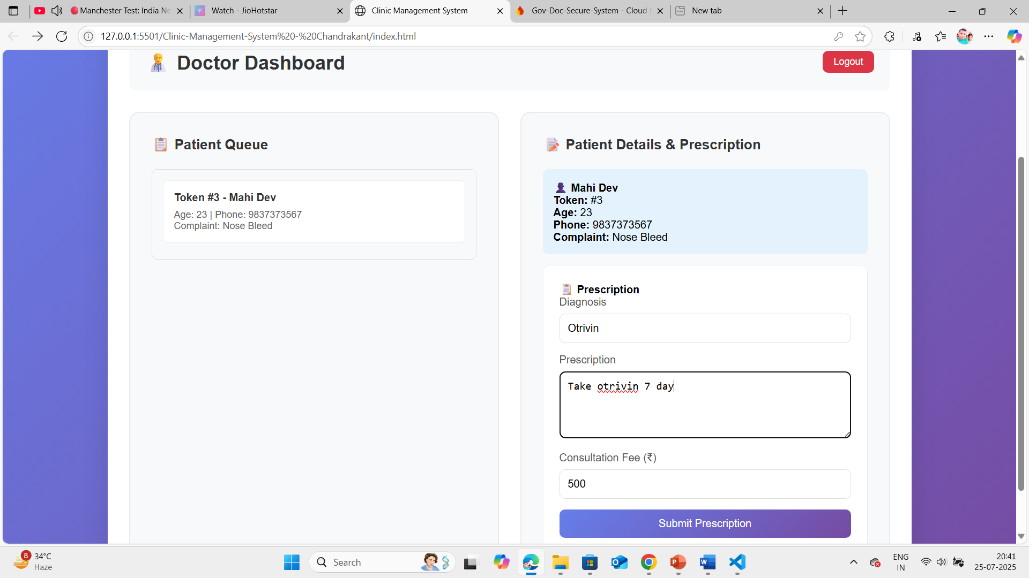
DOCTOR DASHBOARD AND PATIENT QUEUE

Slide 25
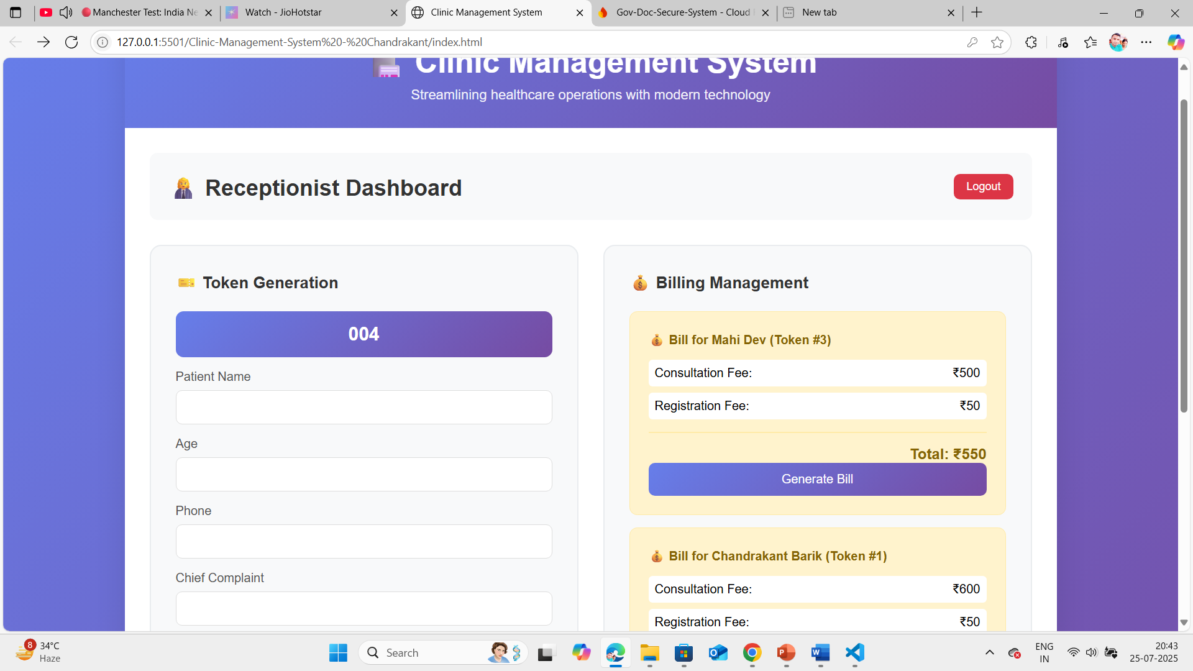
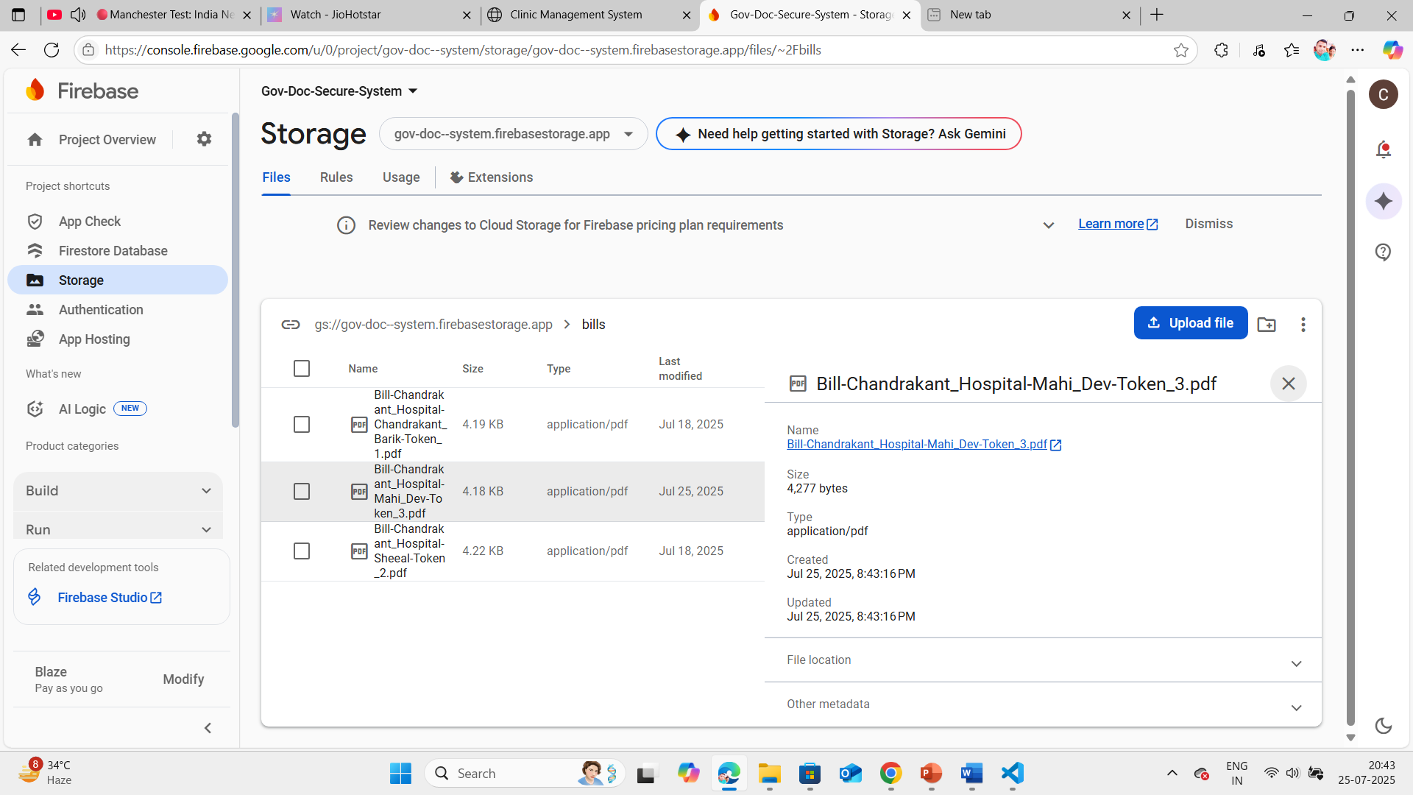
RECEPTIONIST WILL GENERATE BILL WHICH WILL BE SAVED IN BILL OF STORAGE OF FIRESTORE AND PDF GENERATED
BILL PDF IN STORAGE

Slide 26
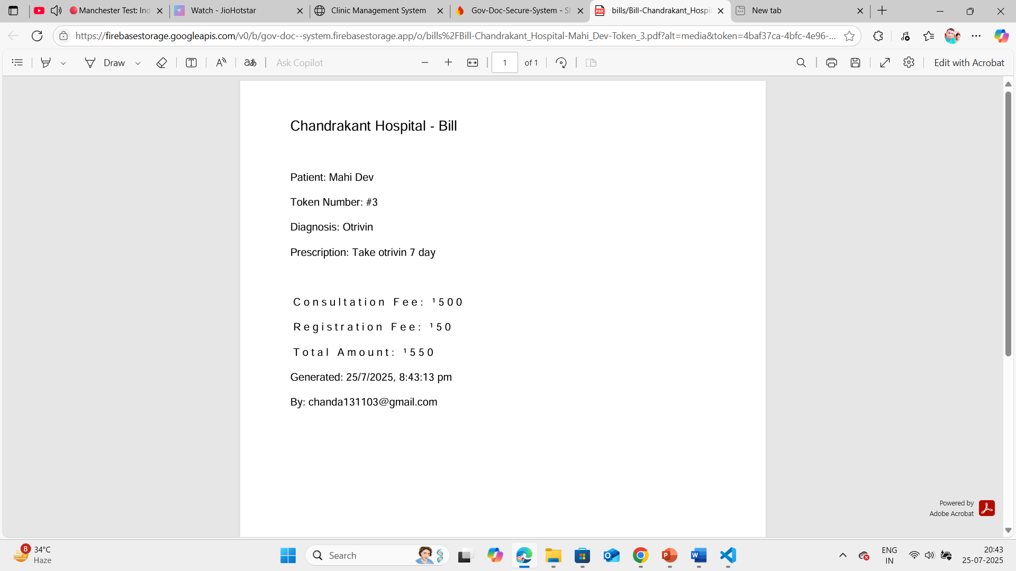
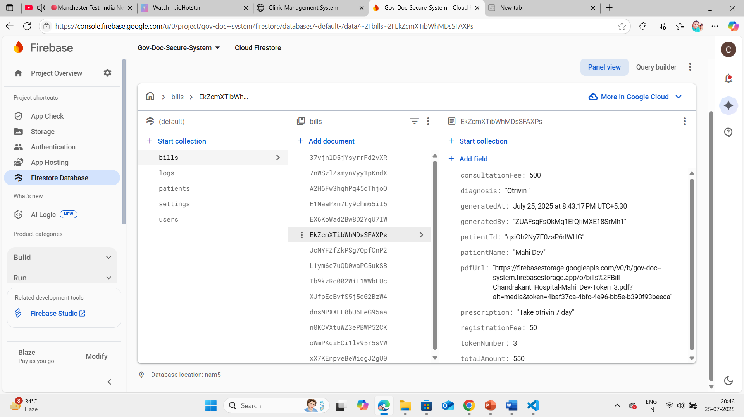
BILL WILL BE SAVED IN FIRESTORE DATABSE

Slide 27
Basic
1)weather app Github Repository Link: https://github.com/chandrakant131103/Weather-APP---Unified-Mentor-UM-
2)image slider Github Repository Link : https://github.com/chandrakant131103/Image-Slider--Unifield-Mentor-UM-
3)interactive quiz Github Repository Link : https://github.com/chandrakant131103/interactive-quiz-Unified-Mentor-UM-
4)Interactive Infographics Github Repository Link : https://github.com/chandrakant131103/Interactive-Infographics-Unified-Mentor-UM-
advanced
5)Secure & Share Govt Document with Family Members Github Repository Link : https://github.com/chandrakant131103/Government-Document-Sharing-Portal-Unified-Mentor-UM-
Netlify Hosted Link : https://neon-hummingbird-3ec4fa.netlify.app/
6)clinic management system Github Repository Link : https://github.com/chandrakant131103/Clinic-Management-System---Unified-Mentor-UM-
Netlify Hosted Link : https://gregarious-naiad-8abe52.netlify.app/

